Slide 1
Building a Strong Spirit

Slide 3
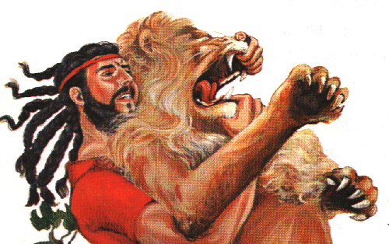
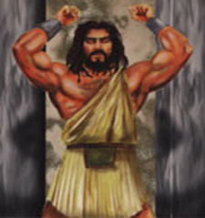
How to Build and Maintain a Strong Spirit

Slide 4
THESIS:
THREE ATTITUDES that will weaken our spirits.
2. THREE HABITS that will strengthen our spirits.
Building a Strong Spirit

Slide 5
THREE ATTITUDES THAT WEAKEN MY SPIRIT:
Building a Strong Spirit

Slide 6
THREE ATTITUDES THAT WEAKEN MY SPIRIT:
1. Self-indulgence weakens my spirit
You weaken your spirit when you make decisions based on pleasure rather than principle.
Building a Strong Spirit

Slide 7
To be strong in spirit, I must discipline my desires.
Building a Strong Spirit

Slide 8
1 PETER 4:1-2
NIV
“Since Christ suffered in His body, arm yourselves with the same attitude, because he who is disciplined in his body is done with sin. As a result, he does not live his life for evil human desires, but rather for the will of God.”
Building a Strong Spirit

Slide 9
THREE ATTITUDES THAT WEAKEN MY SPIRIT:
2. Resentment weakens my spirit.
Samson’s mistake is that he reacts instead of acts.
Building a Strong Spirit

Slide 10
JOB 5:2
NIV
“Resentment kills a fool, and envy slays the simple.”
Building a Strong Spirit

Slide 11
JOB 18:4
NIV
You who tear yourself to pieces with your anger!
To be strong in spirit, I must control my reactions.
Building a Strong Spirit

Slide 12
PROVERBS 29:11
NASU
“A fool always loses his temper, but a wise man holds it back.”
Building a Strong Spirit

Slide 13
THREE ATTITUDES THAT WEAKEN MY SPIRIT:
3. Carelessness weakens my spirit.
Building a Strong Spirit

Slide 14
PROVERBS 18:20
NKJV
“Death and life are in the power of the tongue, and those who love it will eat its fruit.”
Building a Strong Spirit

Slide 15
To be strong in spirit, I must develop good habits.
Building a Strong Spirit

Slide 16
EPHESIANS 6:10
Today’s English Version
“Build up your strength in union with the Lord and by means of His mighty power.”
Building a Strong Spirit

Slide 17
THREE HABITS THAT STRENGTHEN MY SPIRIT:
1. Get time with God every day
Building a Strong Spirit

Slide 18
PSALM 25:4
“Show me the path where I should go, O Lord; point out the right road for me to walk.”
Building a Strong Spirit

Slide 19
LUKE 5:16
Jesus often withdrew to a lonely place and prayed.
Building a Strong Spirit

Slide 20
JOHN 15:7
“If you remain in me and my words remain in you, then you may ask for anything you wish, and you shall have it!”
Building a Strong Spirit

Slide 21
THREE HABITS THAT STRENGTHEN MY SPIRIT:
2. Get together with believers often!
Building a Strong Spirit

Slide 22
HEBREWS 10:25
“Let us not give up the habit of meeting together … Instead, let us encourage each other …”
Building a Strong Spirit

Slide 23
THREE HABITS THAT STRENGTHEN MY SPIRIT:
3. Give purposely, liberally, and cheerfully every first day of the week (I Cor 16:1-2, 2 Cor 9:7).
Building a Strong Spirit

Slide 24
MATTHEW 6:21
“Wherever your treasure is, your heart will be there.”
Building a Strong Spirit

