Slide 1
Ancient inscriptions confirm the bible (1)
lessons for building faith in the historical record of the Bible

Slide 2
Pharaoh Shishak’s Campaign of conquest in Israel (925 BC)
Event is recorded in 1 Kings 14:25-26//2 Chronicles 12:1-12; Occurred during the reign of King David’s grandson Rehoboam
Known as the Bubastite Portal, the Shishak Inscription, the Shishak Relief
South entrance to First Court of the Temple of Amun at Karnak, Egypt
Lists Egypt’s allies, confirming biblical record (2Chron. 12:3)
Lists captured cities in Judah, confirming biblical record (2Chron. 12:4)
Mentions “Field of Abram” and “Heights of David” (the latter reference is within 50 years of David’s death and is one of the few references archaeologists have found to David that occurs outside of the Bible!

Slide 3
Pharaoh Shishak’s Campaign of conquest in Israel (925 BC)

Slide 4
The battle of qarqar (853 BC)
The battle itself is not recorded in Scripture, but this is significant in that it mentions King Ahab of Israel whose reign is detailed in 1 Kings 16-22.
Inscription of Assyrian King Shalmaneser III known as the Kurkh Stele/Monolith
Battle between Assyria and a coalition of 11 kings, including King Hadad-ezer of Aram and King Ahab of Israel
Backdrop of King Shalmaneser III and description of the battle. Specifies King Ahab of Israel by name and how many forces he sent to the fight.
The stele confirms numerous truths about numerous different aspects of what is revealed in Scripture as to the nature of Ahab, the Assyrians, and the state of things at this point in history.

Slide 5
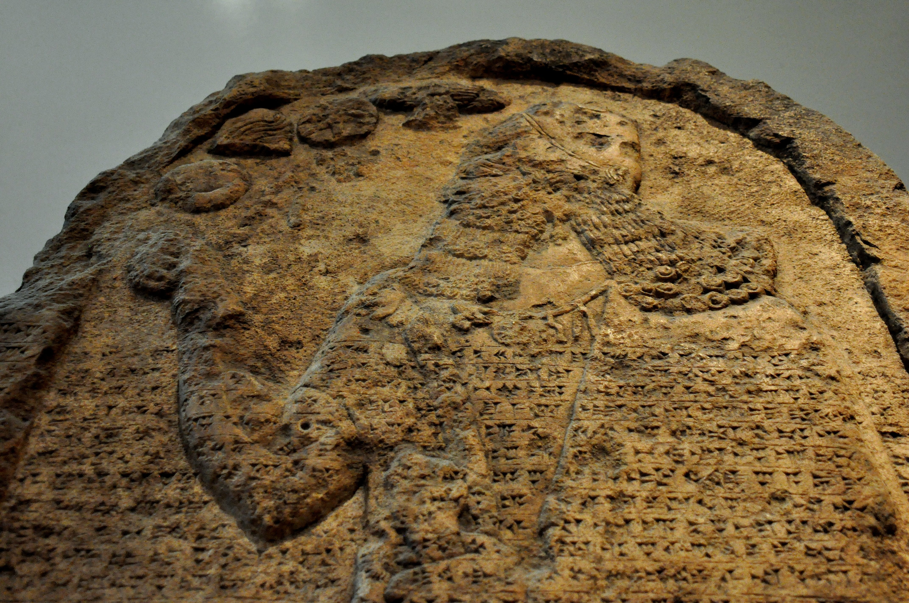
The battle of qarqar (853 BC)

Slide 6
Moabite Rebellion Against Ahab (850-840 BC)
Event recorded in 2 Kings 3:4-27
Historically verified in the Mesha Stele/Inscription; also known as the Moabite Stone
Mentions YHWH by name and identifies as the God of Israel/Judah.
Mentions Israel’s Omride dynasty, most noted for King Ahab, and their “oppressive” regime against King Mesha of Moab
Mentions “House of David” in connection to the biblical city Horonaim. Despite attempts by critics to dismiss this, the translation has been validated by 3D imaging.
The monument has been fought over, broken, pieces hidden, and then recovered. Thankfully, a rubbing of the original unbroken monolith has been used to help reconstruct the still missing portions with great confidence.

Slide 7
Moabite Rebellion Against Ahab (850-840 BC)

Slide 8
Murder of Israel’s King Jehoram & Judah’s King Ahaziah (840 BC)
Event recorded in 2 Kings 9:21-24
Historically verified in the Tel-Dan inscription
Originally, just one portion was found. On this piece, the phrase “House of David” was found. Skeptics debated the rendering, but two more pieces of the inscription were later found and confirmed. Skeptics who formerly denied the existence of David and dismissed the biblical narrative as a myth were exposed.
The inscription specifies the deaths of Jehoram/Joram, son of Ahab, king of Israel and Ahaziah, son of Jehoram, king over the House of David (i.e., Judah) during a conflict against Hazael, king of Aram. Hazael takes credit for their deaths, but the Bible specifies that it was at the hand of Jehu that they fell.

Slide 9
Murder of Israel’s King Jehoram & Judah’s King Ahaziah (840 BC)

Slide 10
Tribute of Jehu to Shalmaneser III (825 BC)
The Bible VERY briefly records Jehu’s reign, focusing more on Jehu’s purging of the house of King Ahab (2 Kings 9-10).
King Ahab of Israel is historically verified in the Black Obelisk of Shalmaneser III.
Israel was beginning to fracture (2 Kgs. 10:32-33). Later, Assyrian King Shalmaneser V would exact tribute from King Hoshea of Israel (2Kgs. 17:3).
The Black Obelisk has 20 panels across 4 sides, displaying five conquered kings bringing tribute and bowing before Shalmaneser III. Jehu’s panel is the second from the top and is the earliest known depiction of a biblical king.
“I received the tribute of Jehu son of the people of the land of Omri: silver, gold, a golden bowl, a golden vase with pointed bottom, golden tumblers, golden buckets, tin, a staff for a king and spears.”

Slide 11
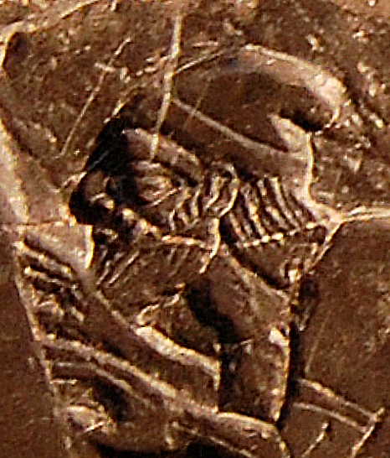
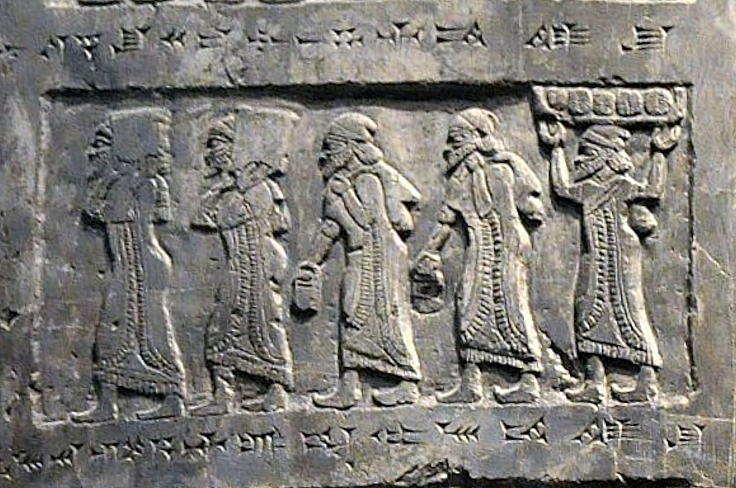
Tribute of Jehu to Shalmaneser III (825 BC)

Slide 12
Tribute of Jehu to Shalmaneser III (825 BC)

Slide 13
Christopher Eames, “The Three David Inscriptions,” Watch Jerusalem, January 28, 2021
“With the Karnak inscription and Mesha Stele, we have a total of three ‘David’ inscriptions—part of a now almost rapidly-growing body of evidence for the king. The question is no longer if David existed, but just how powerful he was. Was it as the Bible says? It’s a question often posed by archaeologists, and regularly written about by journalists.”
“From the excavations of ‘David’s Palace’ in Jerusalem, to the ‘Davidic’ cities of Khirbet Qeiyafa, Khirbet a-Ra’i, Tel ‘Eton and more, to foreign sites the Bible records that he dominated during his reign (such as Tel et-Tell and Timna)—the burgeoning archaeological evidence closely parallels the biblical account of David in scope and territory. From his relationship to the Philistines, to evidence of import of copper to Jerusalem from Edom, to his ties to the northern Geshurite kingdom, to the collapse and ‘Dark Ages’ of virtually every other surrounding nation at the time—the list goes on.”
“King David has remained, to this day, one of the most revered, respected, immortalized individuals in history. Such legendary figures are not built on thin air. And as archaeology is demonstrating, this one certainly wasn’t.”

Slide 14
The Bible is real, actual, factual history. In these pages is reliable, testable information. In these pages are given an accurate, precise account of the events of the world. In this book, we find God’s historical record of the disaster that has ensued because people have chosen to violate His standards for His creation. All of us have fallen short.

