Slide 1
Ancient inscriptions confirm the bible (1I)
lessons for building faith in the historical record of the Bible

Slide 2
Inscriptions From lesson 1:
The Shishak Inscription mentions “Heights of David” and “Field of Abram” and confirms Egyptian incursions into Israel (925 BC)
The Kurkh Stele verifies King Ahab’s reign over Israel (853 BC)
The Mesha Stele mentions YHWH, the royal house of Omri over Israel, Moabite rebellion under King Ahab, and the dynastic house of David over Judah (850-840 BC)
The Tel Dan Inscription mentions the “House of David” and the murders of King Jehoram of Israel and King Ahaziah of Judah (840 BC)
The Black Obelisk of Shalmaneser verifies King Jehu’s tribute to Assyrian King Shalmaneser III (825 BC)

Slide 3
Assyrian Campaign in Israel by King Tiglath-Pileser III (732 BC)
Events recorded in 2 Kings 15:19-22, 29-30; 16:5-9; Isaiah 7:1-17
Verified in the Annals of Assyrian King Tiglath Pileser III found at his Nimrud Palace
“I received tribute from…Rezon of Damascus, Menahem of Samaria, Hiram of Tyre…gold, silver, tin, iron, elephant-hides, ivory, linen garments with multicolored trimmings, blue-dyed wool, purple-dyed wool, ebony-wood, boxwood-wood, whatever was precious enough for a royal treasure; also lambs whose stretched hides were dyed purple, wild birds whose spread-out wings were dyed blue, furthermore horses, mules, large and small cattle, male dromedaries, female dromedaries with their foals.”
“As for Menahem I overwhelmed him like a snowstorm and he . . . fled like a bird, alone, and bowed to my feet. I returned him to his place and imposed tribute upon him gold, silver, linen garments with multicolored trimmings, . . . great . . . I received from him. Israel . . . all its inhabitants and their possessions I led to Assyria. They overthrew their king Pekah and I placed Hoshea as king over them. I received from them 10 talents of gold, I,000 talents of silver as their tribute and brought them to Assyria.”

Slide 4
Assyrian Campaign in Israel by King Tiglath-Pileser III (732 BC)
BM 118908
The top of this panel depicts victory over the biblical city of Ashtaroth Karnaim in Gilead.
The middle of this panel includes an inscription describing different campaigns and victories achieved by Tiglath Pileser III.
The bottom is a depiction of the victorious Assyrian King

Slide 5
Assyrian Campaign in Israel by King Tiglath-Pileser III (732 BC)
BM 124961
Tiglath Pileser’s campaigns in Syria (including Israel) and Iran and the tribute he received from these kings, including from King Menahem in Israel.

Slide 6
Assyrian Conquest and Repopulation of Samaria (722 BC)
Events recorded in 2 Kings 17; Isaiah 20:1 mentions his “tartan” and the latter destruction of Ashdod in 712 BC
Verified in the Annals of Assyrian King Sargon II found at his palace Dur Sharrukin, the Sargon Cylinder, & the Babylonian Chronicle (I.i.27-28); It appears that King Shalmaneser V started the invasion and King Sargon II completed the victory
“On the twenty-fifth day of the month of Tebet Shalmaneser (V) ascended the throne in Assyria and Akkad. He ravaged Samaria.”
“(Property of Sargon, etc., king of Assyria, etc.) conqueror of Samaria (Sa-mir-i-na) and of the entire (country of) Israel (Bît-Hu-um-ri-a) who despoiled Ashdod…”
"At the beginning of my rule, in the very first year I reigned I set siege to and conquered Samaria and carried away into captivity 27,290 persons who lived there; I took 50 fine chariots for my royal equipment. The town I rebuilt better than it was before and settled therein people from countries which I had conquered. I placed an officer of mine as governor over them and imposed upon them tribute as is customary for Assyrian citizens.”
“The tribes of Tamud, Ibadid, Marsimanu and Hai-apa, distant Arabs, who inhabit the desert, who know neither high nor low official (governors nor superintendents), and who had not brought their tribute to any king,--with the weapon of Assur, my lord, I struck them down, the remnant of them I deported and settled them in Samaria.”

Slide 7
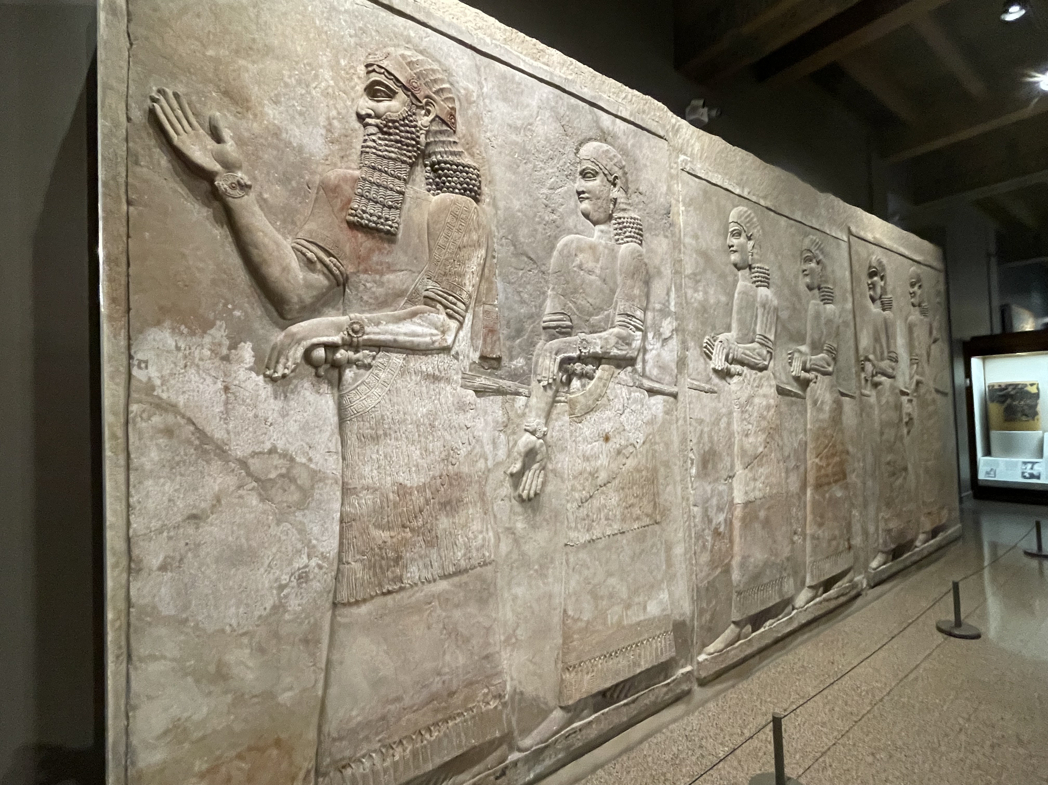
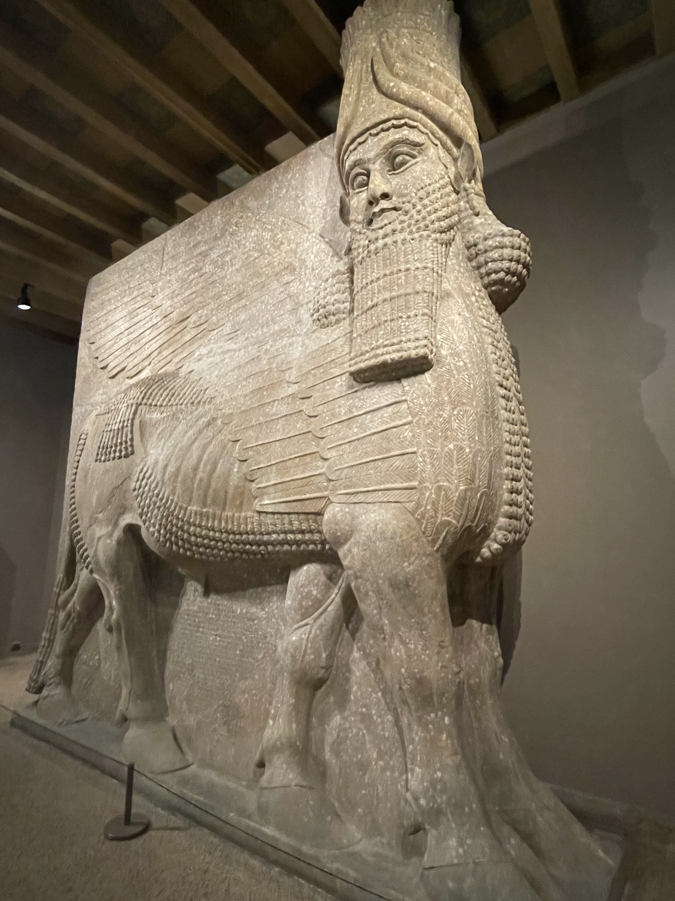
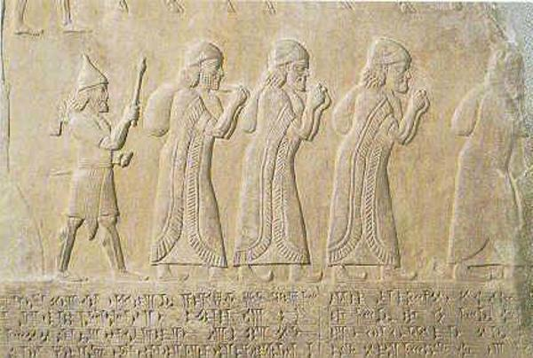
Assyrian Conquest and Repopulation of Samaria (722 BC)

Slide 8
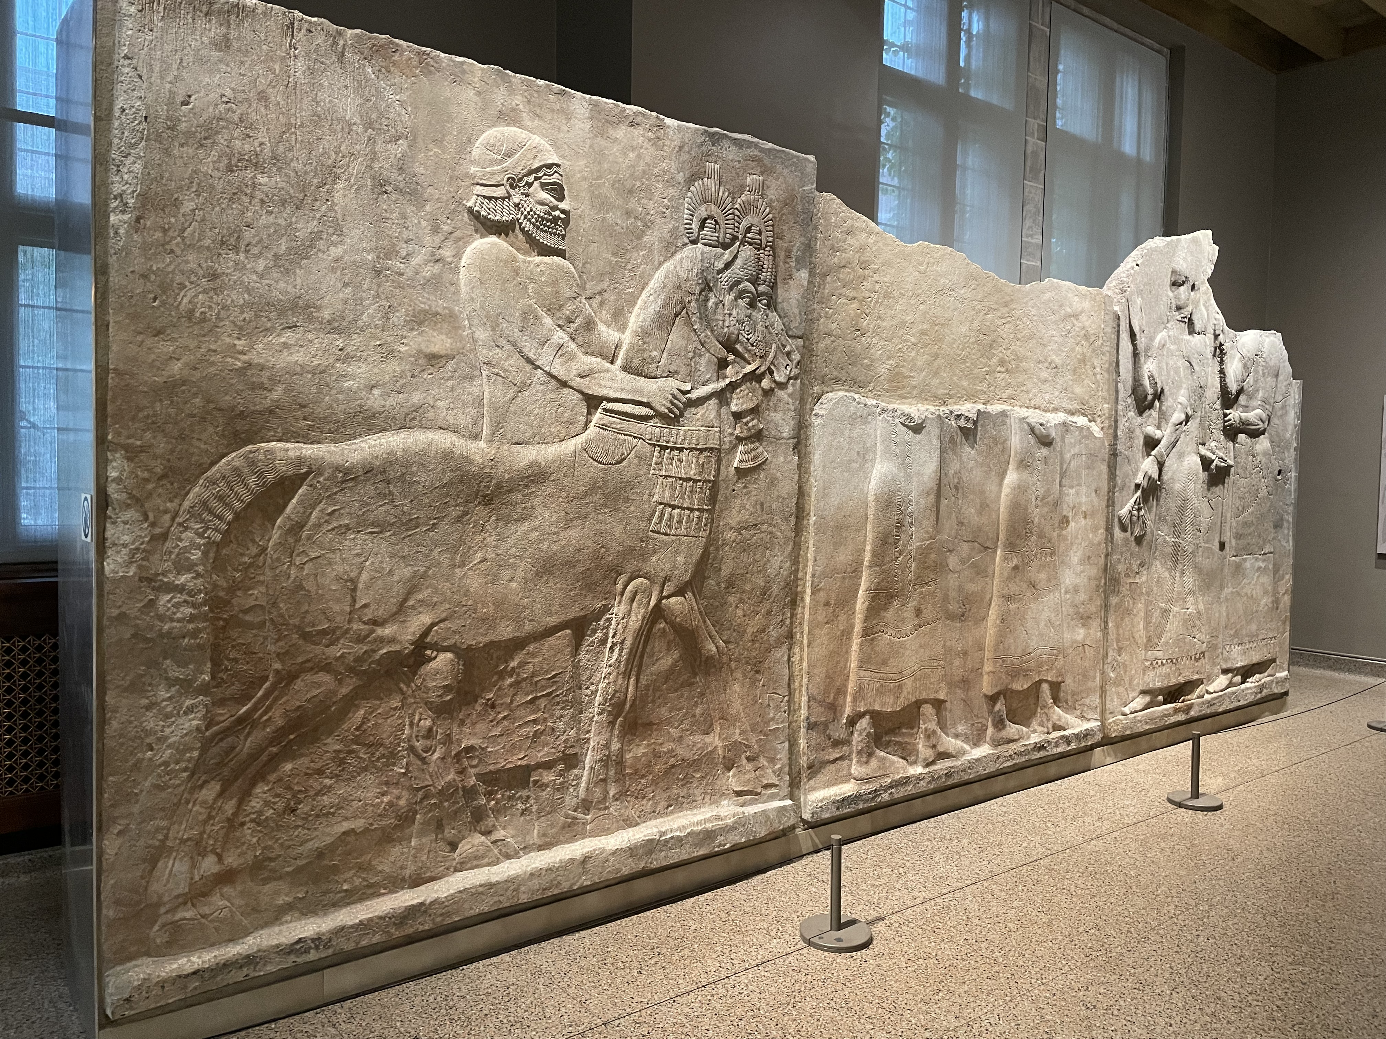
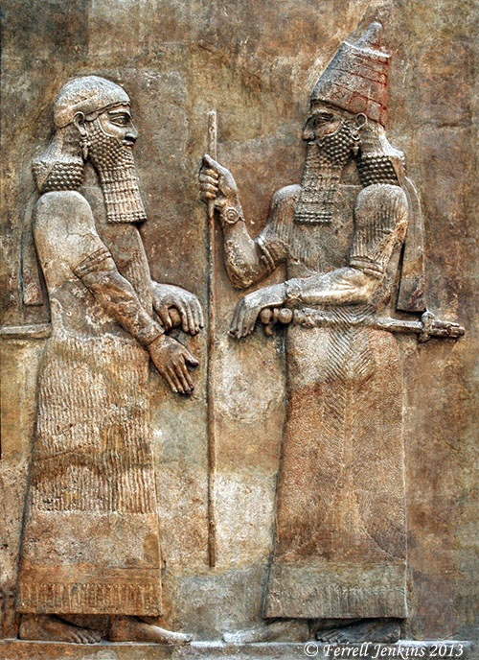
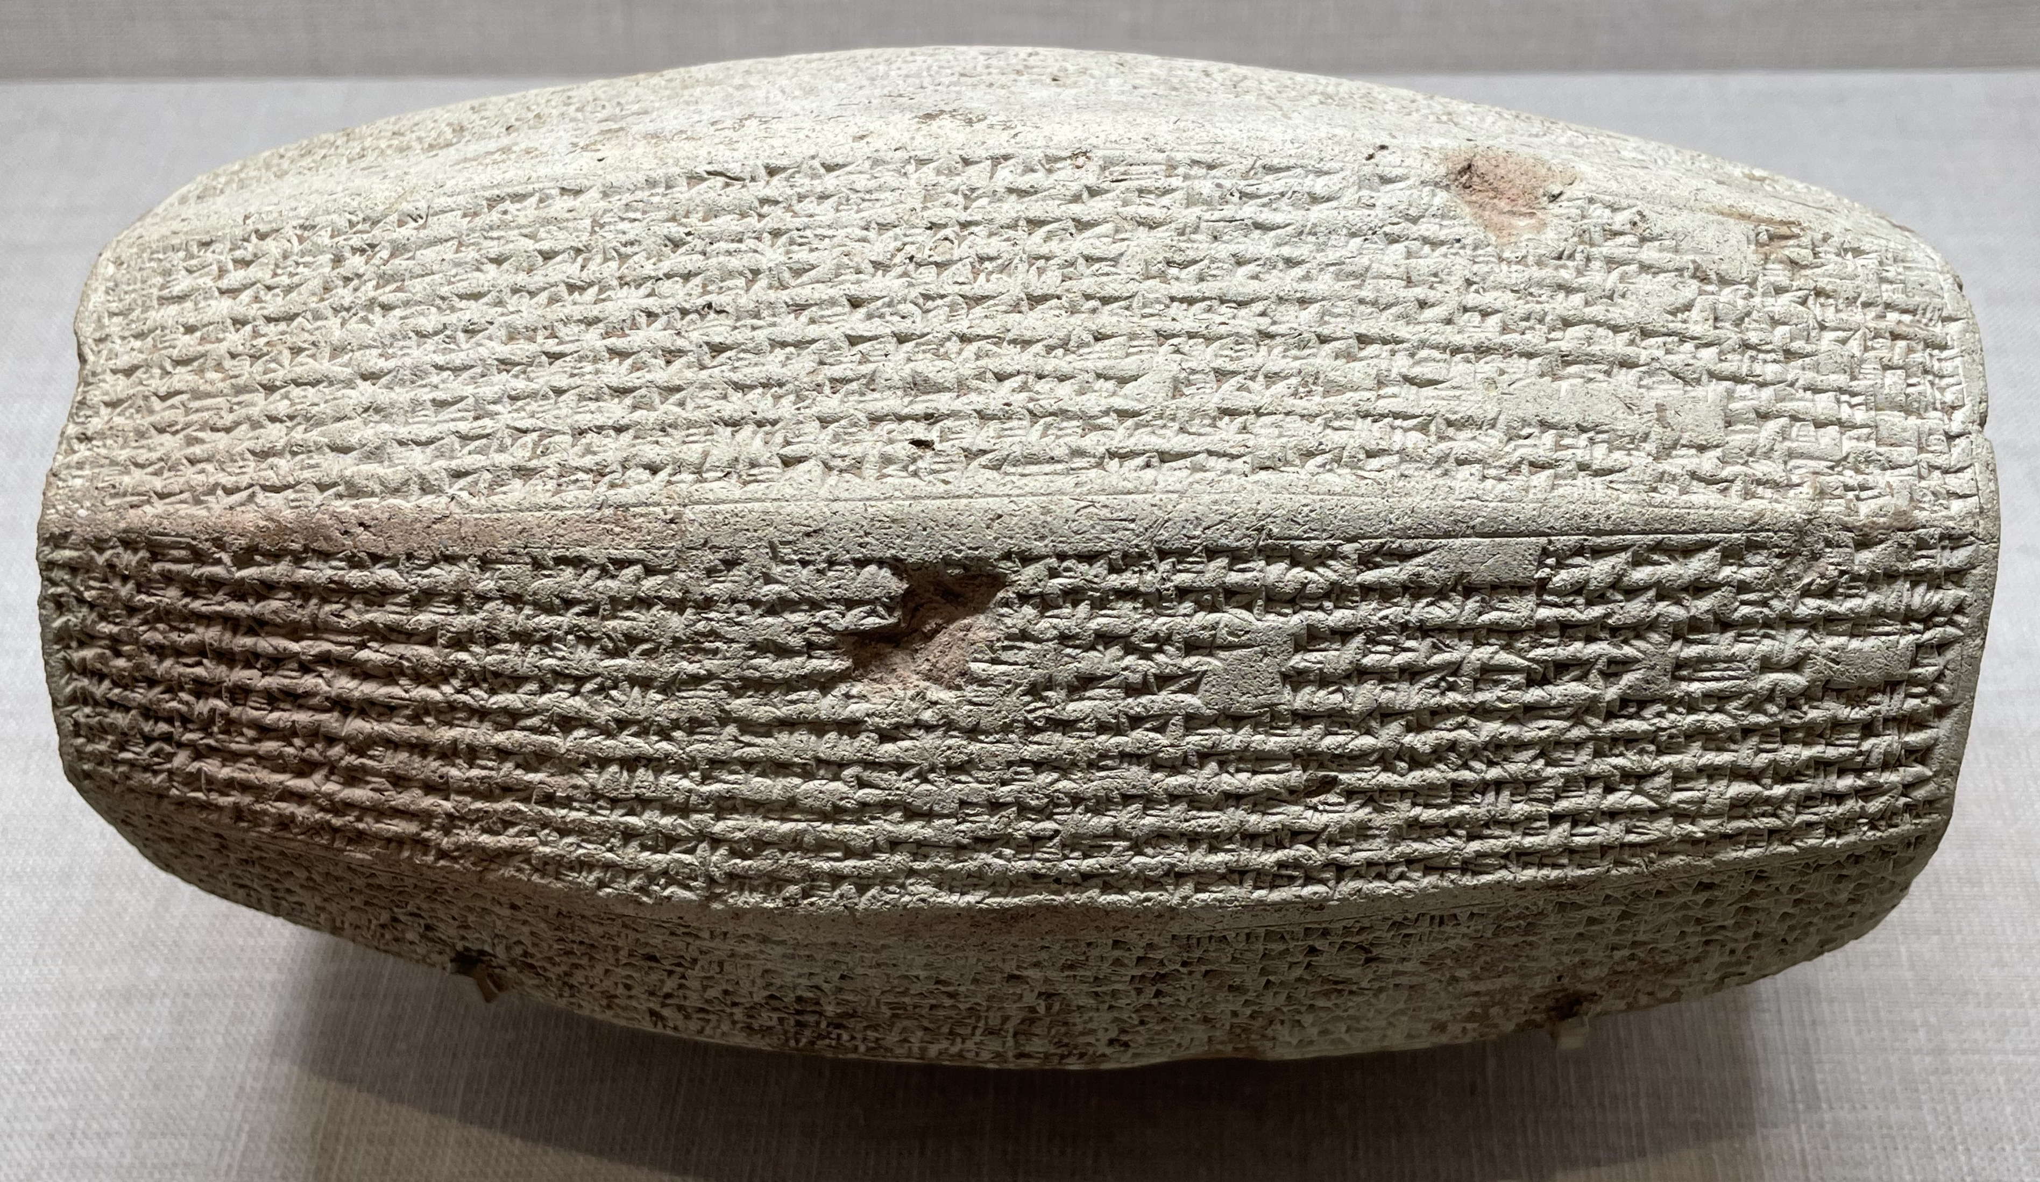
Assyrian Conquest and Repopulation of Samaria (722 BC)

Slide 9
Assyrian King Sennacherib’s Campaign to Judah and Conquest of Lachish in 701 BC
Event recorded in 2 Kings 18:13-17; Isaiah 36-37; 2 Chronicles 32:9
Historically verified in the Annals of Sennacherib recorded on reliefs at his Nineveh Palace & the Prisms of Sennacherib
There are three extant copies of Sennacherib’s Prism: the “Taylor’s Prism” (British Museum), the “Oriental Institute/Chicago Prism,” and the “Jerusalem Prism”)
One section reads: “As for the king of Judah, Hezekiah, who had not submitted to my authority, I besieged and captured forty-six of his fortified cities, along with many smaller towns, taken in battle with my battering rams. ... I took as plunder 200,150 people, both small and great, male and female, along with a great number of animals including horses, mules, donkeys, camels, oxen, and sheep. As for Hezekiah, I shut him up like a caged bird in his royal city of Jerusalem. I then constructed a series of fortresses around him, and I did not allow anyone to come out of the city gates. His towns which I captured I gave to the kings of Ashdod, Ekron, and Gaza."
The Lachish Wall Reliefs are massive, about 39 ft wide and 17 ft tall. Originally, they would have been painted as well!
The inscription on it reads: “Sennacherib, the mighty king, king of the country of Assyria, sitting on the throne of judgment, before (or at the entrance of) the city of Lachish. I give permission for its slaughter.”

Slide 10
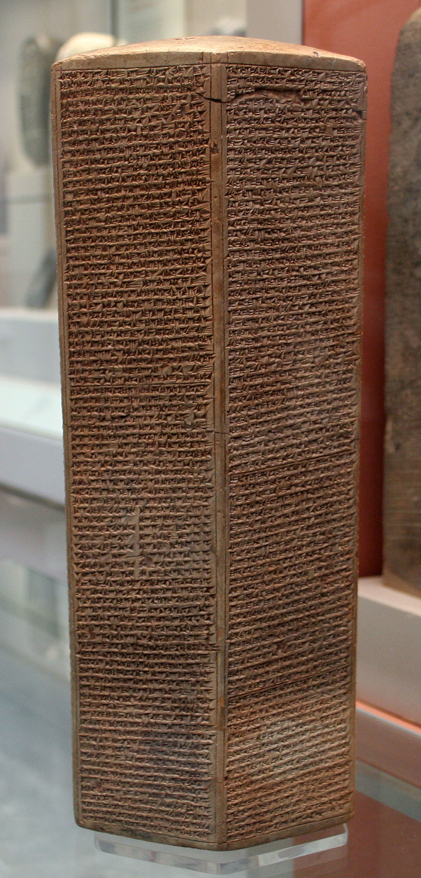
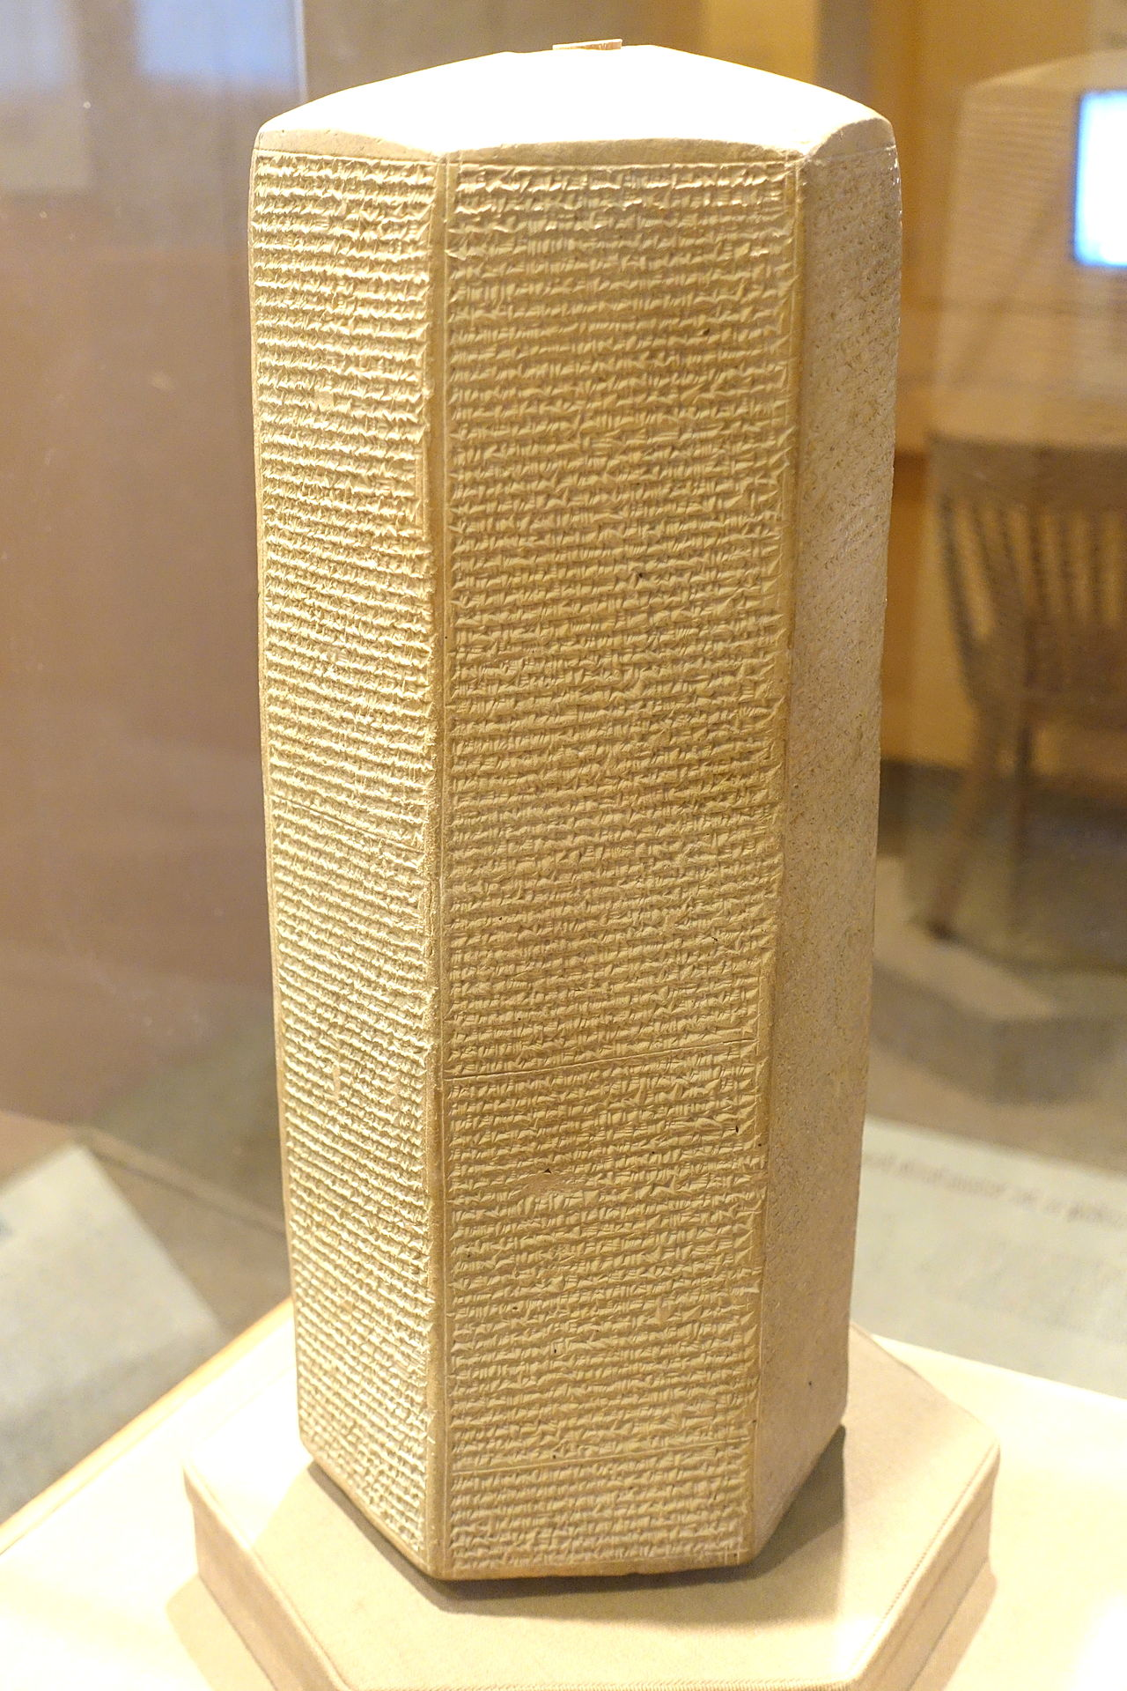
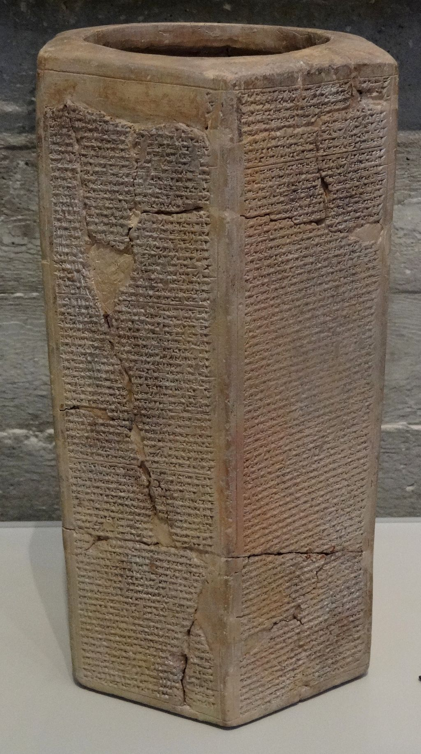
Assyrian King Sennacherib’s Campaign to Judah and Conquest of Lachish in 701 BC
Taylor Prism, London
Oriental Institute Prism, Chicago
Jerusalem Prism, Israel

Slide 11
Assyrian King Sennacherib’s Campaign to Judah and Conquest of Lachish in 701 BC
The massive Lachish Wall Reliefs (BM 124911) at the British Museum

Slide 12
Assyrian King Sennacherib’s Campaign to Judah and Conquest of Lachish in 701 BC
Assyrian forces on siege mound attacking the fortified Lachish
Sennacherib, with scepter in hand and seated on throne, receiving adoration; cuneiform top left

Slide 13
Murder of King Sennacherib by His Sons on October 20, 681 BC
Event recorded in 2 Kings 19:37; Isaiah 37:38
Historically verified in numerous Assyrian & Babylonian sources:
“In the month of Nisan . . . I made my joyful entrance into the royal palace, the awesome place wherein abides the fate of kings. A firm determination fell upon my brothers. They forsook the gods and returned to their deeds of violence, plotting evil . . . . They revolted. To gain the kingship they slew Sennacherib, their father" (Annals of Esar-haddon, Esarhaddon Prism)
“On the twentieth day of the month Tebêtu, Sennacherib, king of Assyria, was killed by his son in a rebellion. For twenty-four years Sennacherib ruled Assyria. After the twentieth day of the month Tebêtu the rebellion continued in Assyria until the second day of the month Addaru. On the eighteenth day of the month Addaru Esarhaddon, his son, ascended the throne in Assyria.” (Babylonian Chronicles, ABC1.iii.34-38)

Slide 14
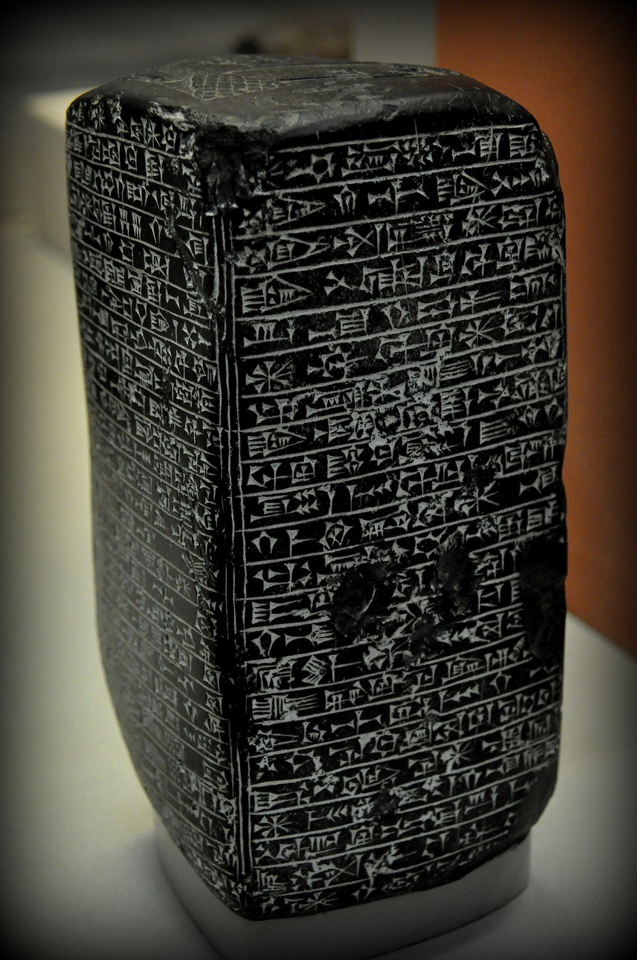
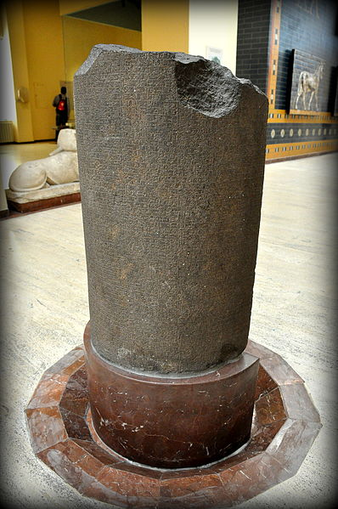
Murder of King Sennacherib by His Sons on October 20, 681 BC
Esarhaddon Prism
BM 121005
Basalt monument of Esarhaddon
BM 91027
Istanbul Stele of Nabonidus
Babylon Chronicle BM 92502

Slide 15
Battle of Carchemish (605 BC)
Event recorded in 2 Kings 23:29; Jeremiah 30; 46:3-12
Historically verified in the Nebuchadnezzar Chronicle, aka Jerusalem Chronicle (Babylonian Chronicles, ABC5, BM 21946)
In 609 BC, King Josiah of Judah attempted to delay Pharaoh Necho II as he marched to assist Assyria against Babylon’s campaign; Josiah’s actions are disapproved by God and he is slain in battle (2 Chronicles 35:22).
“In the twenty-first year [605/604] the king of Akkad [Nabopolassar] stayed in his own land, Nebuchadnezzar his eldest son, the crown-prince, mustered the Babylonian army and took command of his troops; he marched to Carchemish which is on the bank of the Euphrates, and crossed the river to go against the Egyptian army which lay in Carchemish. They fought with each other and the Egyptian army withdrew before him. He accomplished their defeat and beat them to non-existence. As for the rest of the Egyptian army which had escaped from the defeat so quickly that no weapon had reached them, in the district of Hamath the Babylonian troops overtook and defeated them so that not a single man escaped to his own country. At that time Nebuchadnezzar conquered the whole area of Hamath.”

Slide 16
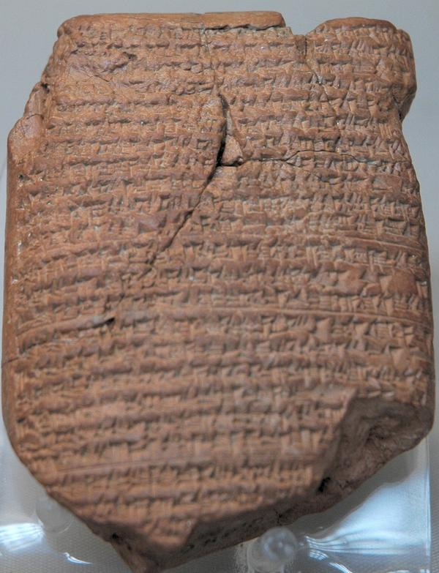
Battle of Carchemish (605 BC)
Babylonian Chronicle BM 21946, obverse and reverse

Slide 17
The Bible is real, actual, factual history. In these pages is reliable, testable information. In these pages are given an accurate, precise account of the events of the world. In this book, we find God’s historical record of the disaster that has ensued because people have chosen to violate His standards for His creation. The accurate record here solidifies the accurate record of the historical resurrection of Jesus.

