Slide 1
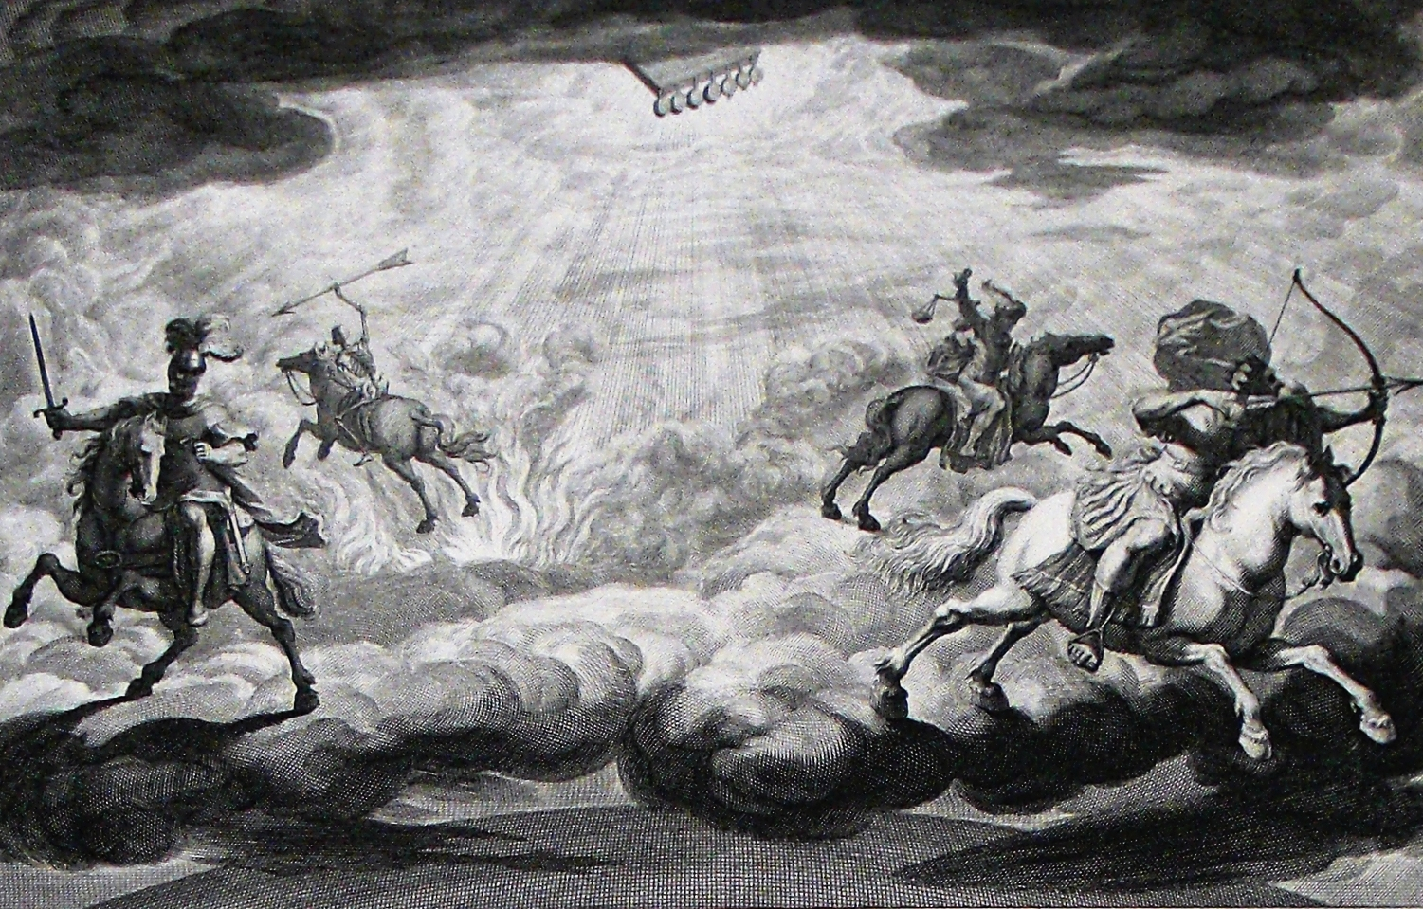
The Book of Revelation

Slide 2
Another Chapter of Encouragement for Troubled Hearts
“If you’ve read [chapter 13] rightly, you have felt the pressure which must have mounted in the minds of the saints. A gargantuan Dragon, frustrated and furious; a horrific sea monster lumbering out of the breakers in answer to the Dragon’s command; a death and resurrection taking place, ‘proving’ that the beast can’t be killed and demonstrating the colossal power of the Dragon; a lamb-like beast coming up out of the very ground and shattering the stillness with the nerve-shattering roar of a dragon’s voice; the tremendous power of this ‘lamb,’ its ‘miracles’ and threats; and last but not least, the spell which has been cast over the whole world as they all become zombie-like devotees of the sea-beast. … What would you want to hear if you’d been a Christian back then? After that lot, what would you want to hear? You’d like to hear chapter 14!” (McGuiggan, 205)

Slide 3
Another Chapter of Encouragement for Troubled Hearts
Chapters 11-13 set forth persecution against the saints. We should be seeing by now that there is not a strict chronological pattern here but different depictions of persecution and protection of God’s people.
“one of the characteristics of this book is the alternation of sharp contrasts between scenes of frightful horror and scenes of welcome serenity.” (Metzger, 77)
Each section is headed by, “And I saw…” (vv. 1, 6, 14)
Debate about whether this is a chapter of temporal judgment/vindication or of the Final Judgment/vindication.

Slide 4
The Lamb, the Redeemed, and the New Song (14:1-5)
Same basic symbols as in chapter 7 – John has a habit of introducing something and then dealing with it in more detail later. This is a trademark of a society that prizes oral tradition.
This group of faithful Christians “is pictured as safe with the Lamb in His stronghold.” (Hailey, 303)
The Lamb – Jesus, Who was also slain for the good confession (cf. chapter 5); the true Lamb in contrast to the false lamb of 13:11 – He does not rise out of the earth or sea, but is displayed above it.
Mount Zion – an image for the people of God (Heb. 12:22f) and symbolic place of Messianic rule (Pss. 2:6; 110:2, 5f; Zech. 9:9); also, where the law of the spirit went forth (Isa. 2:1-4) and where the joy of God’s people arises (Is. 35:10). The singing is great because the multitude is great! They sing a new song (cf. 5:9f; Ps. 98:1; 149; Ex. 15:16) – this song could not be uttered before they became children of God & is a song of deliverance and salvation.

Slide 5
The Lamb, the Redeemed, and the New Song (14:1-5)
The 144,000 – virginity is added; “John appears to adopt the imagery found frequently in the Old Testament where any contact with pagan worship was called ‘fornication’ or ‘adultery.’” (Metzger, 78) Compare 2Cor. 11:2f; Eph. 5:27.This sexual purity may draw on ritual and military purity (Ex. 19:15; 1Sam. 21:4-6). They are also pure in speech (cf. Isa. 53:9) and blameless (cf. 1Pet. 1:19). This purity is a result of following the Lamb wherever He goes (cf. John 13:36; 21:22; Matt. 16:24; 1Pet. 2:21ff; ironic since lambs are usually the ones who are led!). Contrast followers of the beast (13:5f, 15).
The Seal of the Father – Christ’s followers are sealed on their foreheads for their fidelity. Satan’s followers are sealed with the mark of the beast on their foreheads. We either belong to God or to Satan. All have one or the other mark.

Slide 6
Angelic Proclamations (14:6-13)
First Angel (14:6f) – represents the preaching of the eternal gospel to those on the earth, encouraging them to worship God, not Caesar; urging change because judgment is at hand
Second Angel (14:8) – Announces the fall of “Babylon” (i.e., Rome’s collapse, cf. 11:8; Isa. 21:9; Jer. 25:15; 51:8); stated as though it has already happened; described in more detail in chapters 17-19.
Third Angel (14:9-11) – participants in imperial cult worship will be judged – “Dreadful sentence! Filled with the woes of a million eternities. Filled with the echoes of hopelessness. Filled with the blackness of forever!” (McGuiggan, 210). Contrasted with those who abstain. As in the case of Lazarus and the rich man, earthly and eternal fortunes are reversed. The undiluted cup of the wrath of God (cf. Job 21:20; Ps. 75:8; Isa. 51:17; 63:1-6; Jer. 25:15-38; Joel 3:13).
“Faithful saints had suffered public derision, and now their oppressors will experience shame before a more august assembly of spectators.” (Harkrider, 167)

Slide 7
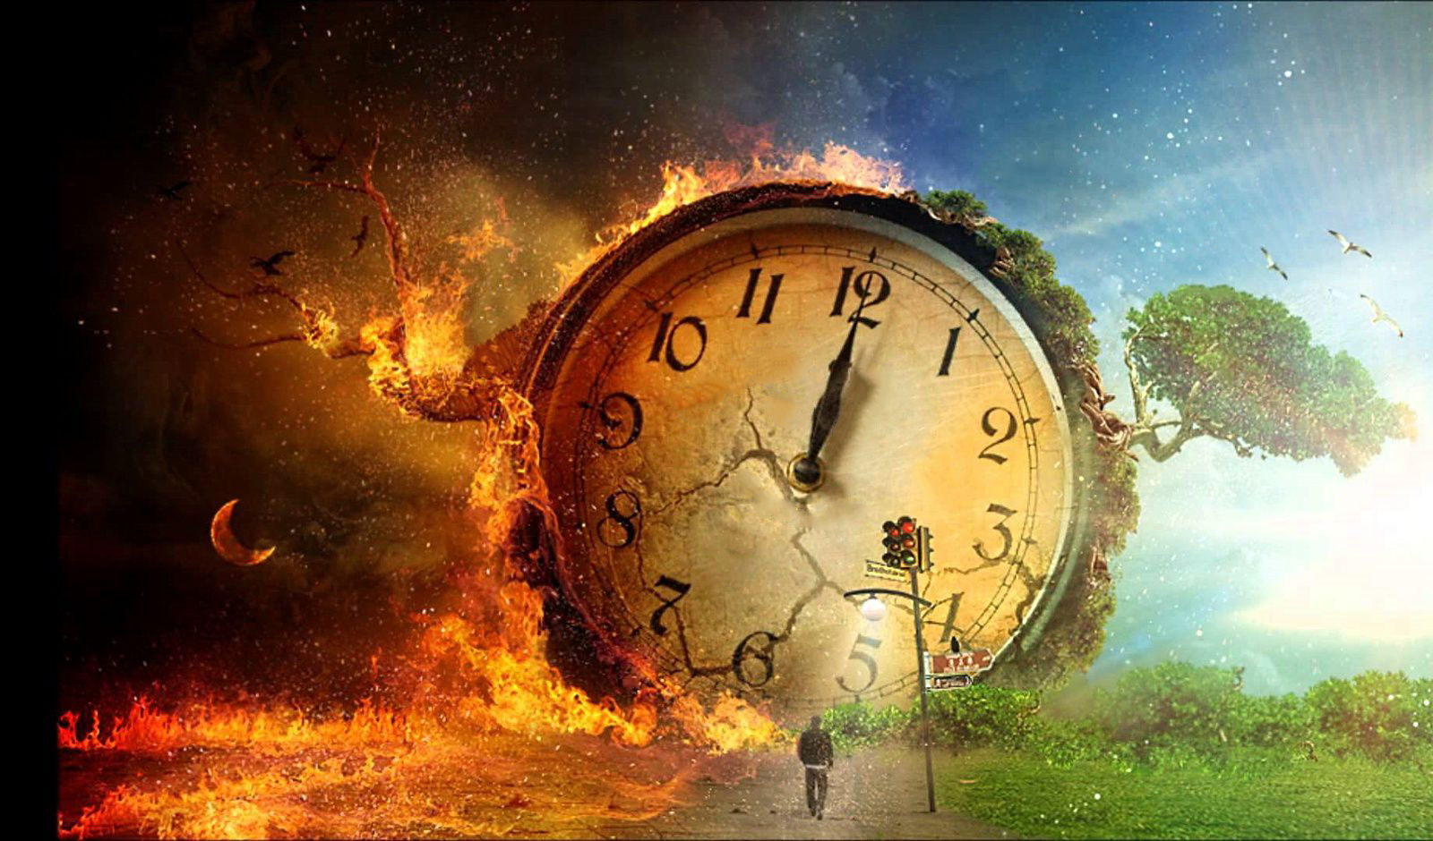
Angelic Proclamations (14:6-13)
Fire and brimstone – Hell in 19:20; 20:10, but likely hyperbolic, temporal judgment here (cf. 4:8; 2Thess. 1:7-9; Gen. 19:24, 28; Isa. 34:9f; Ezek. 38:22)
Verse 12 – Patience, sometimes all we can do is be faithful and wait for God to act (cf. 3:10; 6:11; 13:10; Lk 21:19; James 1:2-4).
Verse 13 – Compare 20:11-15; Ps. 116:15; “Beyond the storms of earthly life is the bright morning of eternity.” (Harkrider, 160)

Slide 8
A Word on the Reality of Hell (Harkrider, 167f)
“Religious materialists such as Jehovah’s Witnesses and Seventh Day Adventists speak of ‘hell’ as only the grave. They deny that the divine punishment is endless…In fact, the Bible speaks of the eternal judgment of God against sin as worse than death (Matt. 10:28). If all that occurs at death is total cessation of consciousness, how could the rejection of Christ bring ‘sorer punishment’ than being stoned to death (Heb. 10:26-31)? Jesus spoke many times of the wicked being cast into a place of torment where there will be ‘weeping and gnashing of teeth’ (Luke 16:19-31; Matt. 22:13; 25:30). Those who attempt to minimize these horrible descriptions of eternal punishment usually ask, ‘How could a loving God cast anyone into a lake of fire and brimstone?’ But this approach play’s on man’s emotion and reasoning that is based on his own shallow experience. Before anyone dares to redefine the consequences of God’s wrath, he should explain why a God of love would allow his only begotten Son to die on the cruel cross of Calvary! Man is not in a position to assess the heinous nature of sin nor to determine what might be its just punishment (Isa. 53:4-6).”

Slide 9
Two Contrasting Harvests (14:14-20)
The Righteous by Jesus
The Unrighteous by Angels
The wheat was dry and ready, a fitting metaphor for the Christians being martyred. The grapes were alluring and plump, a fitting metaphor for the decadent sinners.

Slide 10
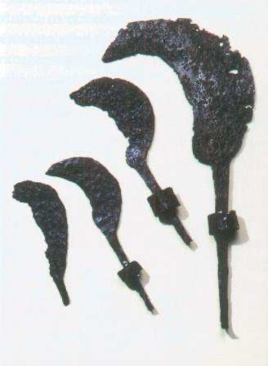
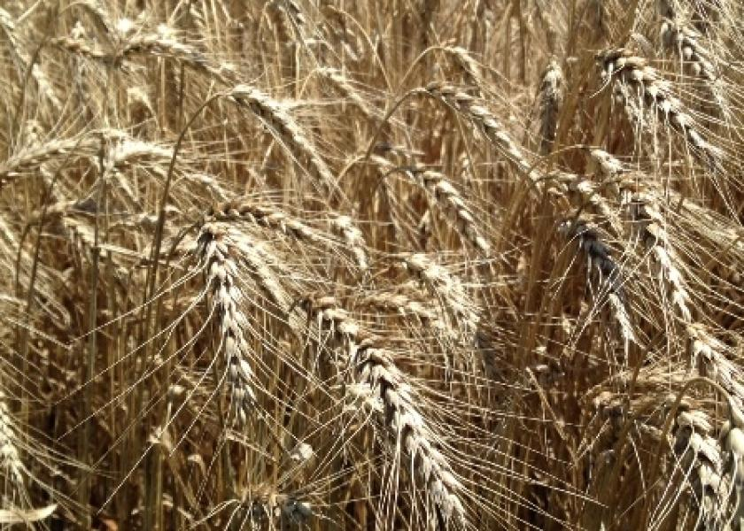
The Harvest Is Ripe! (14:14-20)
Three more angels further describe Rome’s downfall. The Lord of the harvest (cf. 1:13; Pss. 2; 21:1-3) with a sharp sickle punishes the rebellious, vindicating the obedient.
Fourth Angel (14:14-16) – Judgment as a wheat harvest (Matt. 3:12; 13:24-30, 36-43); why is this angel instructing Jesus? The angel is simply conveying the will of the Father (1Cor 15:27). God is gathering the faithful (Matt. 3:12; 9:37f; John 4:34-38; Amos 9:9f).
The suffering of those who persist in rejecting God’s love are self-imposed & self-perpetuated.

Slide 11
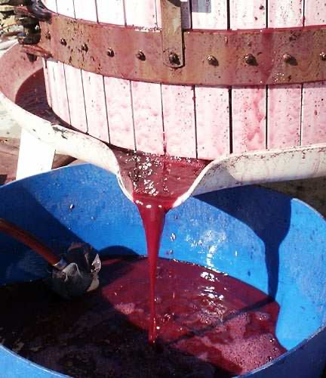
The Harvest Is Ripe! (14:14-20)
Fifth Angel (14:17) – has a sickle and comes from the throne of God (cf. 11:19; 15:5, 8)
Sixth Angel (14:18-20) – From the altar, with power over fire (8:3-5; Isa. 6?), Instructs previous angel to harvest the grapes. Drinking of “Babylon’s wine” (v. 8; 16:19; 17:2; 19:15f; Jer. 51:7, 33), will cause them to be crushed in God’s winepress.
Graphic & gory depiction of widespread death & destruction; blood up to the horse’s bridle & 180 miles in size (cf. Enoch 100:1-3). This trampling occurs outside of the city, i.e., away from the fellowship of God (cf. Joel 3:2, 12; Heb. 13:12f).

Slide 12
The Overall Message

