Slide 1
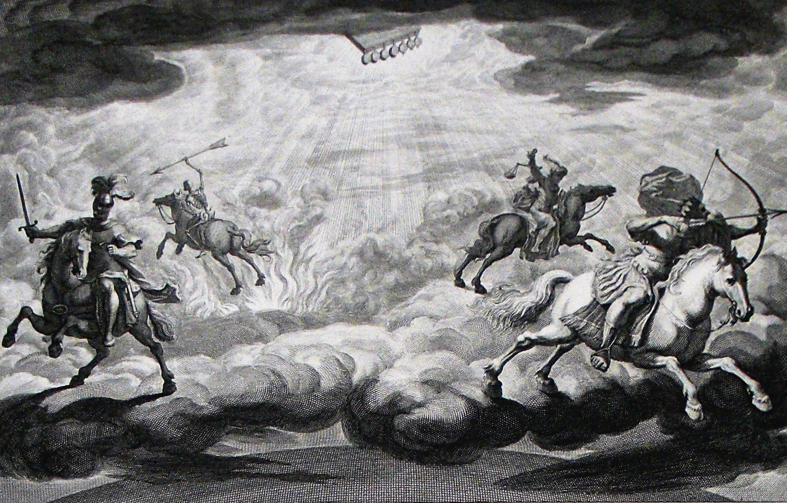
The Book of Revelation

Slide 2
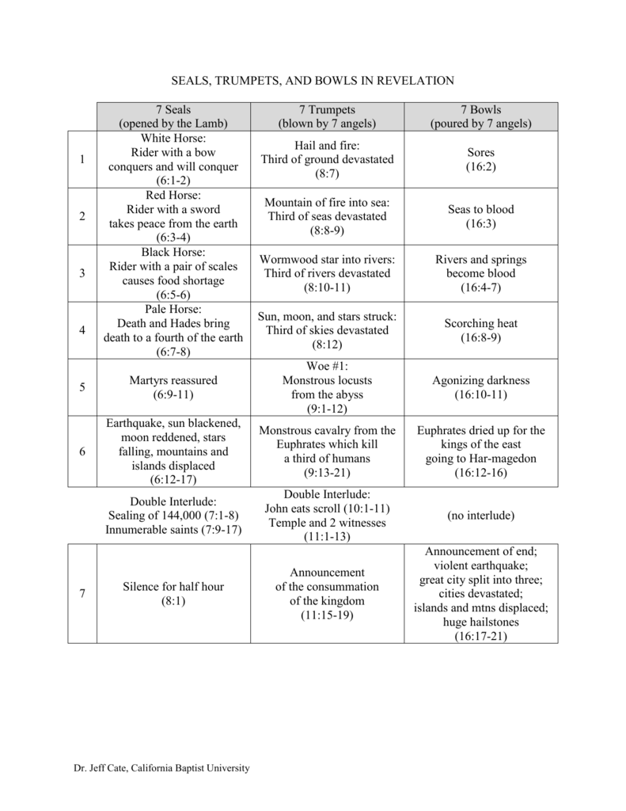
The seven seals reveal, the seven trumpets announce and warn, the seven bowls execute (Lenski, 461)

Slide 3
Setup for the Next Section of Revelation
The opening of the seventh seal led to the seven trumpets (8:1-2). The blowing of the seventh trumpet leads to the pouring out of the seven bowls of wrath (11:15). “The writer of the book of Revelation has carefully laid out a series of parallel and yet ever-progressing panels. These display God’s plan from different vantage points, stressing one or another feature. At the same time, the different accounts reinforce one another and bring before the reader, over and over again, the truth that God rules and overrules in the affairs of humankind.” (Metzger, 80)
This stage of Revelation concerns how God is just and righteous in judging the wicked so thoroughly (15:3; 16:7). In this theodicy, all the participants in the judgment of God are revealed in the rest of the book.
  God’s wrath is poured out in chapters 15-16.
  The destruction of “Babylon” is described in chapters 17-18.
  Christ’s victory is proclaimed in chapters 19-20:10.
  Judgment and the beauty of the new heavens and the new earth are laid out in 20:11-22:1ff.

Slide 4
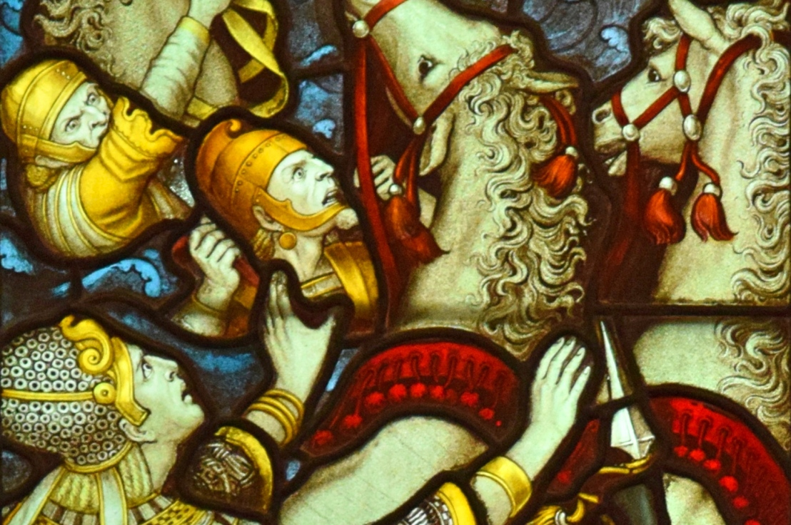
Setup for the Next Section of Revelation
“The visions he saw of God’s enemies, recorded in chapters 12 and 13, were gloomy and full of despair for the saints. But these visions of triumph, in chapters 14 and 15, are bright and full of hope.” (Harkrider, 173)
“Chapter 15 is a reminder that the God of heaven is still in control. That was true then, in the first century. It was true during the Communist terror during the days of the USSR. It is true for those Christians who are in constant danger of death from Islamic terrorism. It is true during a global pandemic that has changed the whole world. It is true for us today. In every way, no matter what we see in the world around us, God is in control of the entire world.” (Roger Hillis)

Slide 5
The Song of Moses & the Lamb (15:1-4)
Seven Angels –
  Introduced in v. 1, their purpose is described more in vv. 5-8
  Seven archangels? Seven angels of the churches? (1:20; chs. 2-3) Symbolic of completeness?
Seven Last Plagues (cf. Ezek. 7:2, 6) –
  God’s way is not to “surprise” mankind with hasty judgments; He gives ample opportunity for repentance
  Last series of seven in the book and consummation of judgment against Rome and the imperial cult which were persecuting Christians
  This sign is overwhelming (“great and marvelous”) because of the completeness of the wrath of God – cf. 12:1, 3

Slide 6
The Song of Moses & the Lamb (15:1-4)
Repeated visions of victorious saints (7:9-17; 11:15-19; 14:1-5) – they are victorious over the beast (13:1ff), his image (13:14), and the number of his name (13:18).
Standing by/near/on a “Sea of Glass” –
  Background #1 – the song of victory at the Red Sea (Ex. 15); not the exact song here, but similar in celebrating God’s deliverance from danger; for this reason, called the “Song of Moses & the Lamb”; definitely a callback to Ex. 15:8 – “The sea congealed on both sides and became a sort of glass crystal.” (Mekilta de-Rabbi Ishmael)
  Background #2 – the bronze laver of God’s house (cf. 4:6)
  Background #3 – Jesus’ calming of the stormy sea (Mark 4:35-41)
“Mingled with fire” –
  Another throne scene preceding a sevenfold judgment scene (chs. 4-5; 8:1-5)
  Fire is a symbol of hardship (1Pet. 1:7; 4:12; Zech. 13:9; Mal. 3:2f)
  Fire as a test leading to purification (1Cor. 3:12-15; Zech. 13:9; Mal. 3:2f)
  Those marked for destruction by the destroyer are marked by God and saved. Having gone through trial, God’s people are in closer proximity to God.

Slide 7
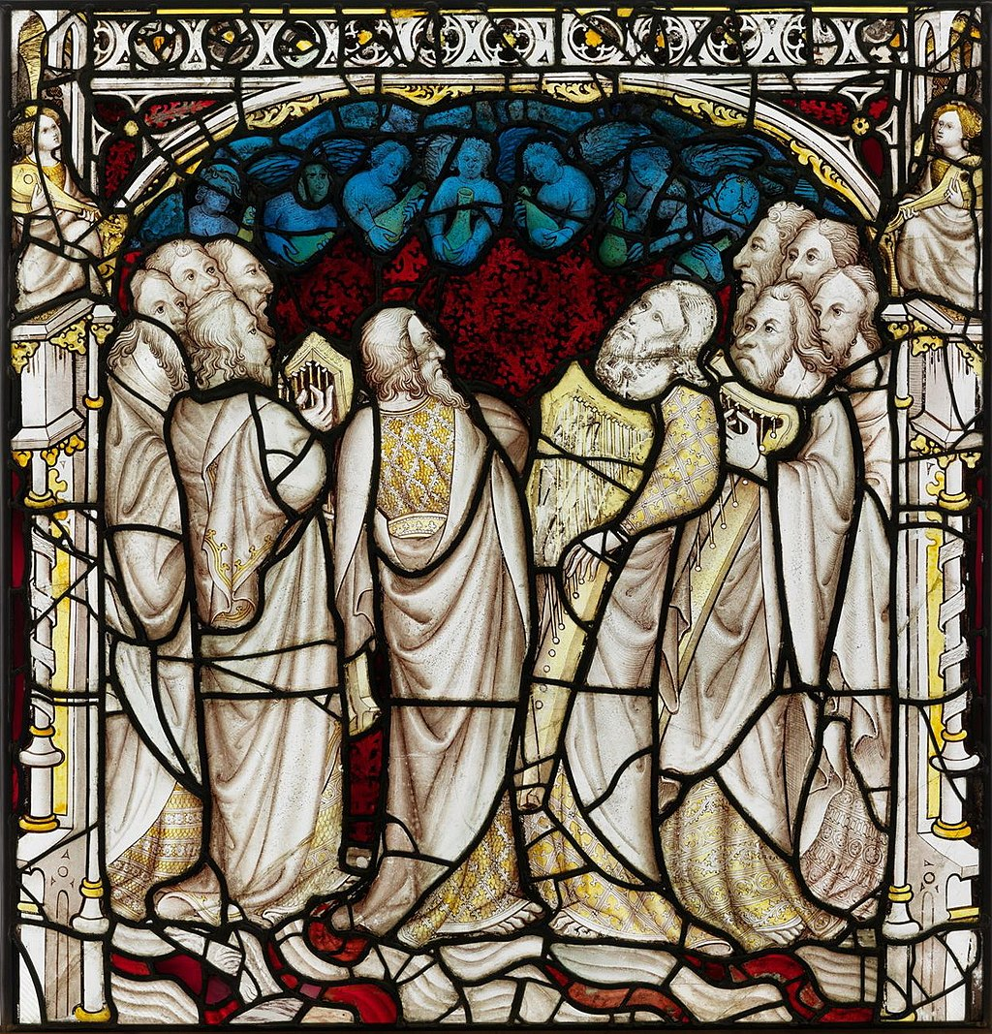
The Song of Moses & the Lamb (15:1-4)
Old Testament background for this victory hymn (Pss. 40:5; 92:5; 98:1; 111:2; 139:14; 145:17; Dan. 9:4; Deut. 32:3f; 7:18; 10:21; etc.)
Singing like harps (5:8; 14:2; 15:2)
The song they sing does not once speak of THEIR achievement. All credit and glory is given to God.
“The hymn itself, like other songs in Revelation, may have been used in the early church. They make some of our modern ephemeral ditties appear incredibly trite.” (Metzger, 82).
“King of all the saints/nations/ages” – cf. Jer. 10:7; Pss. 22:28; 47:8; 86:9f; “the principles which are taught in the book apply to God’s dealings with all nations at all times and so it is just as relevant today as it ever was.” (McGuiggan, 217)
“all nations shall come and worship before You” – cf. Ex. 15:11; Pss. 86:9; 98:2; Jer. 10:7; Mt. 16:26; Phil. 2:10f; Jude 15); “the throne of the universe was not in Italy, but in heaven.” (McGuiggan, 216)

Slide 8
The Song of Moses & the Lamb (15:1-4)
“All the scriptural imagery (harps, crowns, gold, etc.) is, of course, merely symbolical, attempt to express the inexpressible. Musical instruments are mentioned because for many people (not all) music is the thing known in the present life which most strongly suggests ecstasy and infinity. Crowns are mentioned to suggest the fact that those who are united with God in eternity share His splendour and power and joy. Gold is mentioned to suggest the timelessness of heaven (gold does not rust) and the preciousness of it. People who take these symbols literally might as well think that when Christ told us to be like doves, He meant that we were to lay eggs.” (C.S. Lewis)

Slide 9
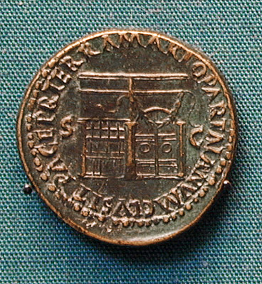
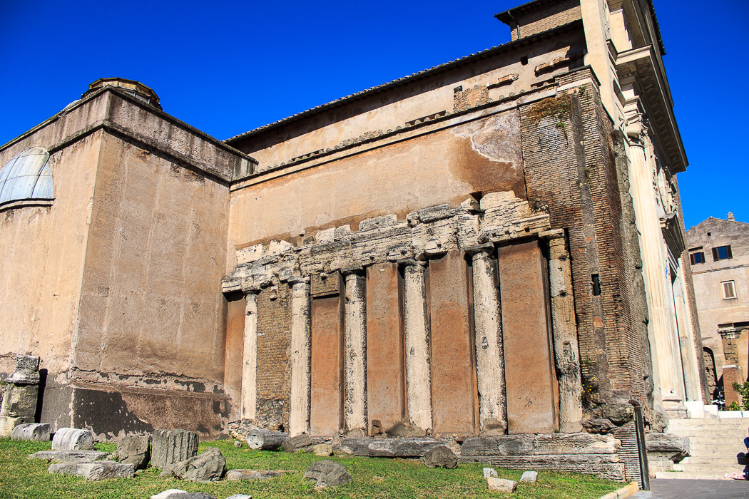
Seven Angels & Seven Bowls (15:5-8)
The angels exit from the inner sanctum, the Holy of holies (Greek: naos)
The tabernacle/temple being open is a cultural allusion to the Temple of Janus indicating God is at war against His enemies (cf. chapter 11)
The angels are clothed in pure bright linen (cf. 19:8, 14; or stones? Ex. 28:21; 39:14; Ezek. 28:13; Isa. 61:10) with golden sashes around their chests (cf. 1:13; Lev. 16:2ff, 23). This is priestly garb and indicates purity and purpose. Angels are portrayed this way in other ancient Jewish literature.
One of the living creatures/cherubim (4:8; 5:8-10; 6:1-8; 1Chron. 28:18; Ps. 104:3; Ezek. 1) gives the angels the bowls of wrath. Which did this is unanswerable and irrelevant. What is being conveyed is heavenly cooperation and orders “directly from the throne.”

Slide 10
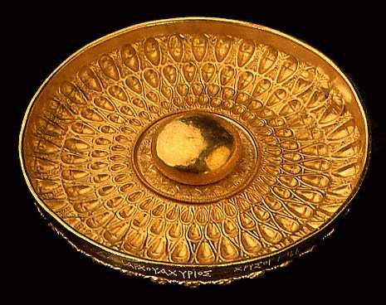
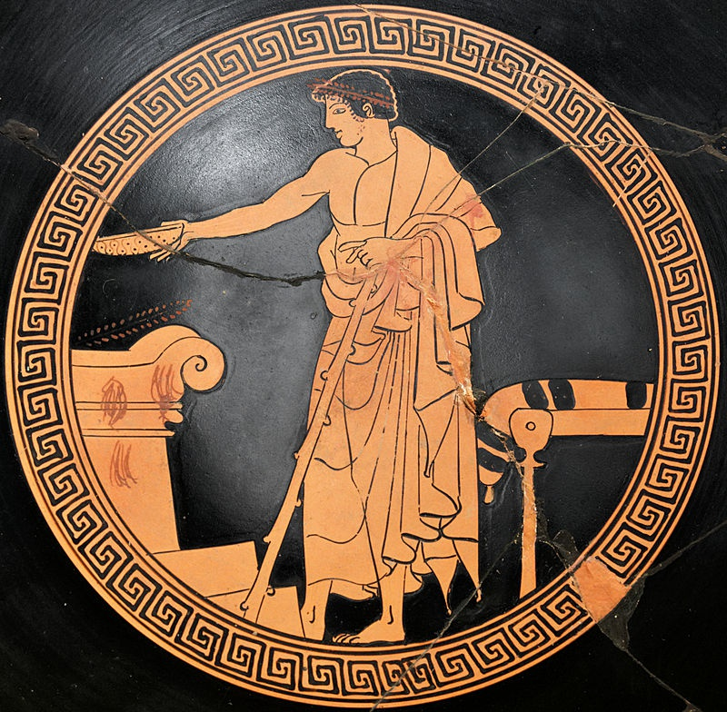
Seven Angels & Seven Bowls (15:5-8)
“Seven plagues” has extensive OT background (cf. Lev. 26:18, 21, 24, 28; Ps. 79:12)
These broad, flat bowls were used for pouring drink offerings (cf. the Phiale of Achyris c. 300 B.C. on right)
God has accepted the offering of the bowls full of the prayers of the saints and has administered His answer through bowls of wrath (cf. Hos. 5:10; Heb. 10:29, 31)
Tabernacle filled with smoke – “It was said by ancient Hebrew writers that when the High Priest entered there, the whole nation stood with bated breath until he returned. And when he did, they say, the breathing again of the people was like the wind passing over the wheat field.” (McGuiggan, 219)
  Presence of God (Ex. 19:18; 40:34f; 1Kgs. 8:10ff//2Chron. 5:13f; Isa. 4:5; 6:4) – God’s deliverance of Israel at the Red Sea is connected to His presence in the sanctuary (Ps. 77:10ff)
  Wrath of God (Num. 16:31-50; Dt. 29:20; Pss. 18:8; 74:1) – “once the hour of judgment is come it will be too late to come knocking, for the door to safety will be closed (Matt. 25:10-13).” (Harkrider, 177)

Slide 11
Context & OT Backgrounds
The Voice of the Lord comes forth from the sanctuary, rendering recompense to His enemies (Isa. 66:6)
“Pour Out” –
  A common metaphor in scenes of God’s wrath (e.g., Ps. 69:24; Jer. 10:25; Zeph. 3:8)
  This is now the 5th time the wrath of God has occurred since chapter 13
  A poetic antithesis of God’s blessings upon the righteous
  Directed toward those who have the mark of the beast and worship its image
  God uses every weapon in His arsenal to bring judgment
“It is just another strike against the gods of the Roman world and the Roman world itself. The bowls are all to be put together and we are to see Jehovah judging the Roman from every angle. He’s attacking the Roman world just as he attacked the Egyptian world. He is here symbolically setting forth that attack!” (McGuiggan, 227)

Slide 12
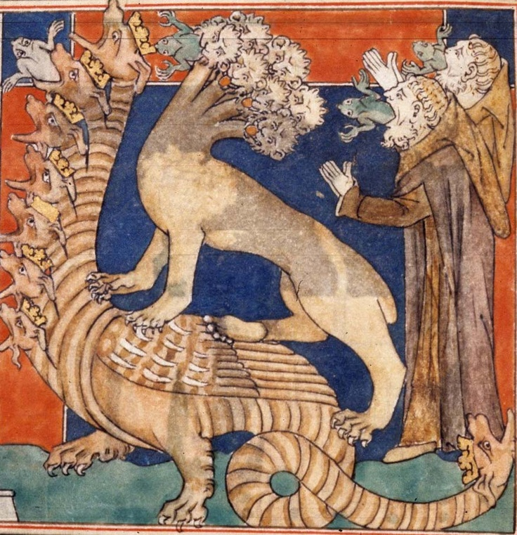
Context & OT Backgrounds
“The author’s descriptive details of the plagues are not to be taken literally, but as contributing to the general effect of intense calamity and terror. As was mentioned earlier, the descriptions are descriptions of the symbols, not of the reality conveyed by the symbols. The justice of God must bring judgment upon individuals and upon nations that violate the moral structure of God’s universe. Like a good teacher, John repeats with kaleidoscopic variety his central conviction that God rules and overrules in the affairs of the church and the world. We might say that John sets up several mirrors in which the same objects are reflected from different sides, so that the reader cannot fail to take note of them.” (Metzger, 82f)
“These signs are revealed in God’s picture book, not as specific events of history, but as scenes in which to visualize the awesome terror of his judgments.” (Harkrider, 180)

Slide 13
Bowl #1 (16:2)
Note the immediate obedience of the angels. There is no delay at this point.
“On the Earth” - in Revelation, the place of the impenitent
“Sore” – cf. the plague of boils on Egypt (Ex. 9:9ff); also, Deut. 28:35
“Mark…image” – mockery of imperial cult lingo; poetic justice (Gal. 6:7f; Prov. 13:15)

Slide 14
Bowl #2 (16:3)
“On the Sea” – Domain of the beast (8:8f; 13:1; cf. Zech. 9:4)
Recalls the first plague on Egypt & also the second trumpet in Revelation
Compare similar OT all-encapsulating historical judgments (e.g., Zeph. 1:2-4; Jer. 5:23ff; Isa. 13:10-13, 17-22)
“Society was dead in sins and trespasses, and now there occurs the blood as of a dead man, putrid and rotting—a revealing illustration of the true nature of the spiritually dead. The result is death to all who come into such a society—not inherited, but consequential death…when the spiritual quality of a society decays, like a sea of coagulated blood from dead men, it putrefies and rots, issuing a foul and obnoxious odor…In such a society, morals decline to the lowest level; the family collapses, schools breed anarchy and rebellion, business ethics are forgotten, entertainment becomes base and sordid, and printing presses exude smut and filth, until the whole is strangled in its own death blood and suffocated by its own stench. Our society too must listen to the trumpet warnings before God pours out the bowls of wrath.” (Hailey, 328)

Slide 15
Bowl #3 (16:4-7)
Similar judgment on rivers and springs (cf. Ex. 7:19)
v. 5 – recalls the cry of 6:10
  “When men pollute, corrupt, and destroy, it is just that they receive a commensurate retribution for their wicked deeds. A servant had poured out the contents of the bowl, but the judgment was from God.” (Hailey, 329)
  “They had made the blood of saints run like water, and now all they can find to drink is blood.” (Harkrider, 181)
“who are and who were” – compare 1:4; an image of sovereignty
v. 6 – poetic justice; lex talionis (cf. Isa. 49:26; Obad. 15f) – “Because they have been so eager for blood, they shall be satiated with blood; it shall be given them to drink, which is more than they had looked for.” (Hailey, 329)
v. 7 – confirmation of v. 5 (cf. 9:13; 14:18; Deut. 32:4); while the heathen drink blood, God’s people drink of living waters (Isa. 12:3; John 4:14)

Slide 16
Bowl #3 (16:4-7)
“Let this ring out: JUSTICE WILL BE DONE. For all the ungodliness done on the earth, a day of reckoning will come. For all the tears of lonely little boys and girls sitting by themselves in the corner of an orphanage wondering what’s gone wrong; for all the hard-working wives who lie senseless beneatht the pounding feet and hands of drunken bums; for all the tortured youths who live under the slavery of the drug traffic; for all the exploited and intimidated youg girls whose lives are full of shame and disgrace; for all the poor who live under the grinding power of the loan sharks; for all the victims of the Mafia; for all the slandered souls; for all those children who were born in the straw and nurtured in infamy—for these, there will come a day! Justice will be meted out. The criminals will pay. If there’s a God, there’s got to be a judgment day. And in that day, the altar will cry out, YES, Lord!”

Slide 17
Bowl #3 (16:4-7)
“All those Roman thieving generals who stole the modesty of sweet young ladies; for those Roman soldiers who raped and plundered; for those howling mobs who watched our brethren and sisters writing in torture; for that Nero, for Domitian, for Diocletian, Decius and Galerius, and the rest of their tribe—their day came in history, but a greater day is yet to come when all the robbed, cheated, raped and ravaged, intimidated and hounded—that day when all the ‘victims’ watch while the cut-throats and villains are placed on trial—THAT DAY IS YET TO COME! Such has been the scandalous treatment of the Family of Jesus Christ, that were there no judgment day, the rocks would cry out—the altar would continue to cry out!” (McGuiggan, 227f)

Slide 18

The Overall Message
“We are being told before the bowls are poured out that this is the work of God. There’s nothing accidental here. This is no Fate or Luck. Here is deliberate and holy judgment poured out on the kingdom of Rome—the current manifestation of the Devil’s moral and spiritual lunacy. The warnings are over—they are ignored.” (Jim McGuiggan, “The Book of Revelation,” Let the Bible Speak Study Series, 216)

