Slide 1
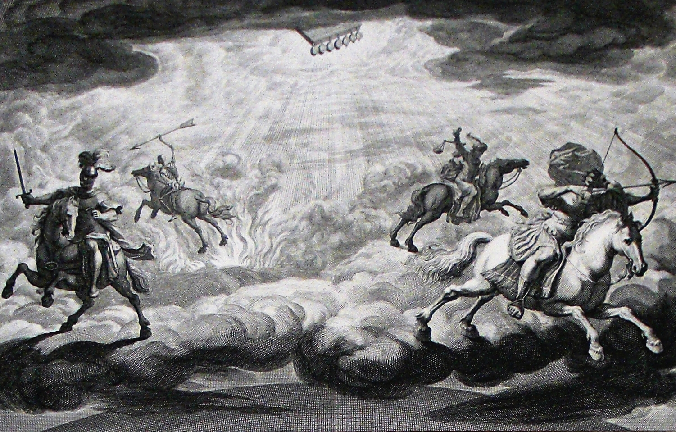
The Book of Revelation

Slide 2
Bowl #4 (16:8-9)
Compare to 7:16; 13:13; Deut. 28:22; Ps. 97:3, 7; Isa. 47:13f; 50:11; anticipates 18:8
“The Romans have been good with fire. They had a lot of practice since the days of Nero when he lit up his gardens with burning Christians. Fire they had and fire he’d give them!” (McGuiggan, 228)
“The source of light, intended to guide, warm, and cheer, is turned into an instrument of pain, for God ‘maketh winds his messengers; flames of fire his ministers’ (Ps. 104:4); all are at His service.” (Hailey, 330)
This bowl will cause sinners to be hardened in their rebellion after the pattern of Pharaoh. Rather than acknowledge Him with glory, they blaspheme Him (9:20f; 13:1, 6; Rom. 1:21)
“This shows the depths of their degradation. When a criminal gets to the point where he blames his victim, his parents, society, the courts, and the prison system for his suffering and his crime as responsible, we call him a hardened criminal. So it is here: these men are hardened sinners, so hardened in fact that repentance is completely absent from their thinking.” (Winters, 190)

Slide 3
Bowl #5 (16:10-11)
The opposite extreme of bowl #4
Compare to the 9th plague on Egypt
Re (Atum) was believed to be incarnate in the pharaoh which would be similar to the imperial cult
God’s people were exempted from the plague of darkness (Ex. 10:23)
Compare also Ps. 69:23; Isa. 9:19
“The agony and despair, the emptiness and sorrow of living unrestrained lives is great. When one begins this path he thinks he is in control, but his confidence is based on the lies of Satan. Rome had its season of sinful pleasures, but internal rottenness brought this great empire to its knees.” Harkrider, 182f)
“wherever world power is worshiped, there the beast has his throne.” (Hailey, 332)

Slide 4
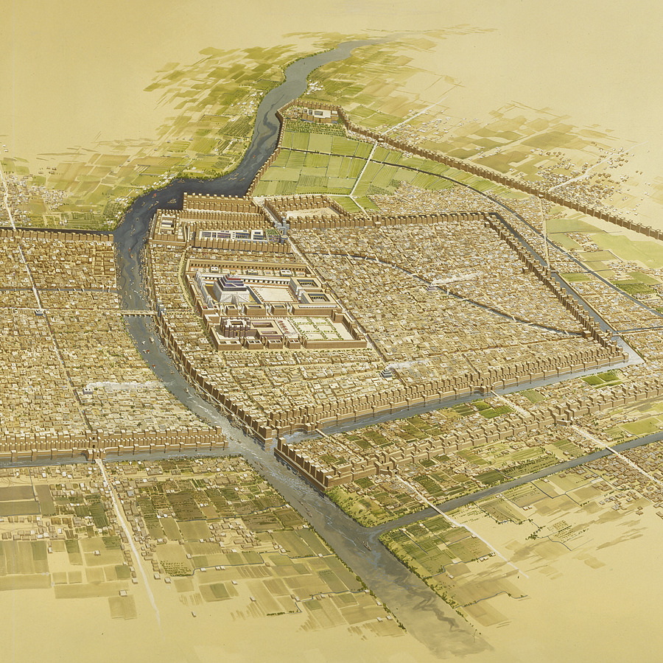
Bowl #6 (16:12)
The “Great River” in the OT is the Euphrates River, the Cradle of Civilization. It was the border between Israel and Babylon.
Introduced in 9:13ff where it was a barrier for the hellish army.
Babylon built on Euphrates River.
The drying up of the Great River is a direct image of judgment taken from the OT prophets and the historical fall of Babylon (Jer. 50:35, 38; 51:35f)
The significance of the drying up of the Euphrates for physical Babylon lie in the fact that it would make the city totally vulnerable
God has proven this power over the waters (e.g., Ex. 14:21f; Josh. 3:15-17; 2Kgs. 2:7-14; Is. 11:1-16; 51:10; Ps. 106:9; Zech. 10:10-12)

Slide 5
Satan’s Forces Fight Back (16:13-16)
“kings from the east” – God’s direction (cf. Isa. 41:2)
The false prophet is the land beast from chapter 13
All three in the “unholy trinity” conspire together to fight back against the Father, Son, and Holy Spirit
“Three Unclean Spirits” – unclean (Lev. 11:9ff) characterizes “Babylon”
Behind the false gods are demonic powers (cf. 1Cor. 10:20f). This relationship has been a topic for many recent publications (e.g. Gospel Over Gods by Tyler Gilreath and The Unseen Realm by Michael Heiser)
These “frogs” stir up rebellion in the war between God and evil, two rival kingdoms
“the great day of God” – in the OT, a time of judgment on God’s enemies; “‘The great day of God’ is a day of judgment, but not the final or ultimate judgment, for there will be no battle fought at that time—all will be over.” (Hailey, 335)
The deception that recruited these allies becomes an invitation to their destruction (cf. 12:15f; 13:5, 14-17, 11ff; 19:20; Ps. 2:2). God permits deception for the depraved (1Kgs. 22:19-23). Their signs are exposed (cf. Matt. 24:24; 2Thess. 2:9; 1Tim. 4:1).

Slide 6
Satan’s Forces Fight Back (16:13-16)

Slide 7
Satan’s Forces Fight Back (16:13-16)
Another beatitude – Jesus will come as a thief in His temporal judgments and also at the Final Judgment (cf. 3:3; Lk. 12:39f; 1Thess. 5:2, 4; 2Pet. 3:10)
“Har-magedon” – “Mountain of Megiddo”
This is one of those places where transliteration rather than translation has done a great disservice to Bible students
Means “mountain of slaughter” and is a symbol; there is no such literal place – Tel-Megiddo, while impressive because of its 20+ settlement layers, is only a hill of about 70 feet in the midst of a flat valley
Megiddo was a famous place of battle in the OT where pagan nations fought God’s people (e.g., Judges 5:19-21; 2Kgs. 9:27; 23:29). The “Valley of Megiddo” is another name for the Jezreel Valley.
“To look for a physical military battle between human armies to be fought in northern Palestine at some future date is completely without scriptural support and foreign to the spirit and purpose of Revelation.” (Hailey, 337)

Slide 8
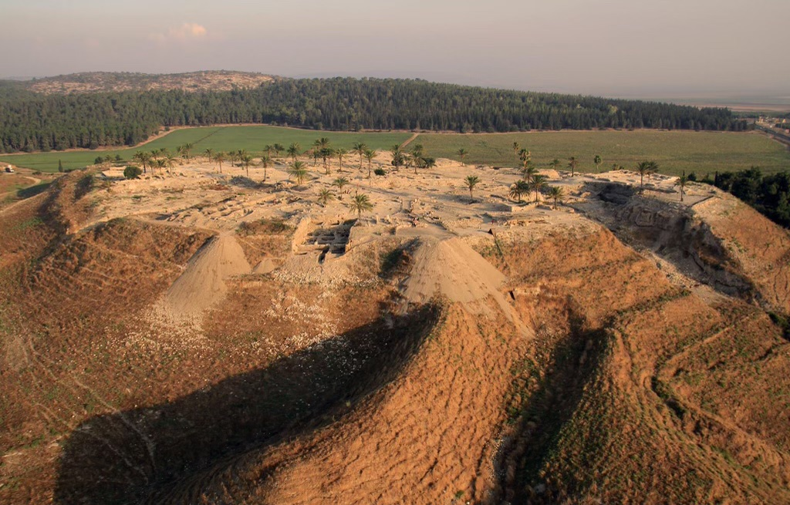
Satan’s Forces Fight Back (16:13-16)

Slide 9
Bowl #7 (16:17-21)
A “loud voice” (cf. v. 1) – typical of divine pronouncements, especially judgment
vv. 17f, 21 – Poured out “on the air” – compare the Egyptian plague of hail and also Josh. 10:11; is this a symbol for God attacking the domain of Satan? (Eph. 2:2)
v. 19 – “Babylon” (11:8, 13; 14:8; Ezek. 5:2f) & all its allies are destroyed – note “cities of the nations” – “Thoroughness of description is obtained when the unit is divided. The city is utterly destroyed being divided by three.” (McGuiggan, 233)
v. 20 – all nature flees from the wrath of God and their world is turned upside down (cf. the sixth seal in 6:14; Pss. 18:7-15; 97:4f; Isa. 2:12ff; Jer. 4:23ff; Ezek. 26:18; Mic. 1:2-4; Nah. 1:5)
v. 21 – hail sufficient to kill instantly; cf. Ex. 9:18-26; Pss. 78:47; 105:32; Josh. 10:11); still they blaspheme!

Slide 10
The Overall Message

