Slide 1
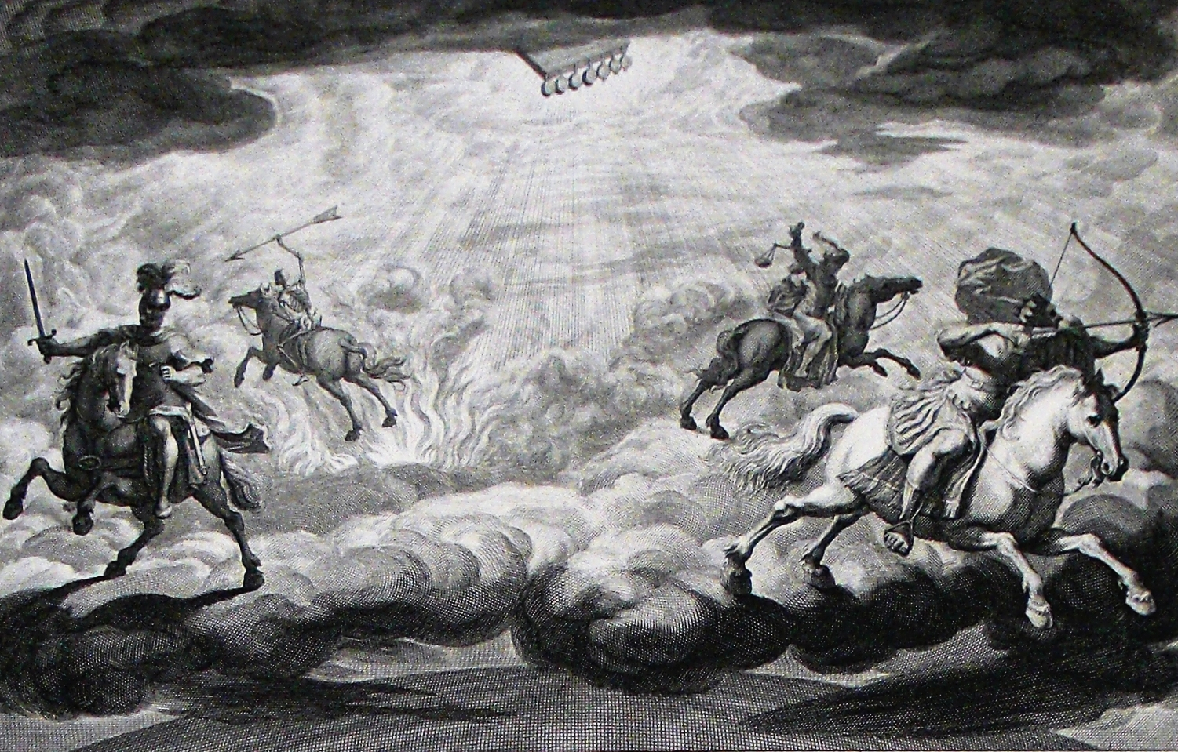
The Book of Revelation

Slide 2
A Tale of Two Women…
“The character and lot of two women and two cities occupy a prominent place in the second section of the book. Chapter twelve opened with the introduction of a woman arrayed with the sun, having the moon under her feet and a crown of stars upon her brow. She gave birth to a man child, the Christ, and was then forced to flee into the wilderness, where she was nurtured and protected. She had other children, those who kept the commandments of God and held the testimony of His Son. Now a second woman is introduced—a harlot, the direct opposite of the first—who is arrayed in all the embellishments of earthly splendor. She has on her forehead a name which identifies her as the mother of the harlots of the earth. Each woman is further identified as a city, the latter as the great city, Babylon, which holds sway over the kings of the earth who make war against the saints. The fall of Babylon has been introduced and now the nature of the city and its complete fall are enlarged upon. The first woman, arrayed in light, is identified as ‘the beloved city’ (20:9), the holy city, New Jerusalem, ‘made ready as a bride adorned for her husband’ (21:2). These two women, and the cities they personify, stand in direct antithesis to each other in character, position, and destiny.” (Hailey, 341)

Slide 3
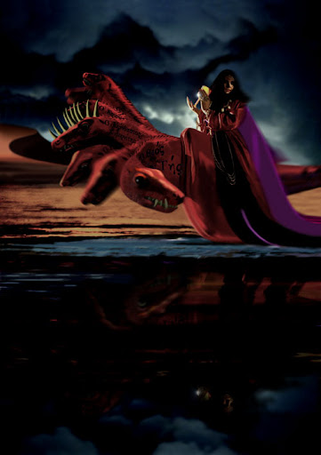
The Big Question: Is This About Rome or Jerusalem?
v. 1 – Describes Rome well, but not land-locked Jerusalem
v. 4 – Rome was the seat of royal power when John wrote; Jerusalem was not
v. 9 – An unmistakable reference to the seven hills of Rome
v. 18 – Cannot be true of Jerusalem, but was true of Rome
Clearly, Old Testament descriptions of pagan cities, and sometimes even Jerusalem itself, are a huge source for the imagery

Slide 4
The Harlot Astride the Beast (17:1-6)
v. 1 – John has a front row seat for this vision of judgment coming upon Rome, the superpower of Satan at that time (foreshadowed in 14:8; 16:19; contrast 21:9). McGuiggan, 237 calls this the, “obituary of Babylon [Rome]”
v. 3a – To witness this vision, John is carried in the Spirit (cf. Ezek. 8:3) to the wilderness, a place devoid of God’s presence and providence (cf. Zeph. 2:13; Isa. 21:1, 9; Mal. 1:3). Contrast 12:6, 14 where the wilderness is a place of protection for God’s people.
vv. 2, 6 – Rome’s patrons, and the harlot herself, were all drunk on the fleshly indulgences she guaranteed as the current superpower (cf. Jer. 51:7; Isa. 29:9; Hab. 2:5, 15)
All the kings of the earth are carried away by her provocation (v. 2; 18:3; 11ff; 15-17, 19). She is depicted as a harlot who both sits upon the beast and upon many waters (clarified in v. 15 – “peoples, multitudes, nations, and tongues”; cf. Jer. 51:13). She has truly captivated the fleshly minded with her widespread corruption.
The treatment of the “witnesses” (lit. martyrs) identifies this subject as the clear enemy of God’s people. Christians, the ideal citizens of any country, became the scapegoat for all manner of ungodly cruelty (cf. 18:24).

Slide 5
The Harlot Astride the Beast (17:1-6)
vv. 3-5 – A harlot sitting on a scarlet beast
She represents a great empire/city (v. 18), raised up by satanic forces, violently opposed to God’s people.
Blasphemous names, 7 heads, 10 horns explicitly connects with the sea beast of 13:1ff & his master, the dragon. Compare 13:7/17:15; 14:9f/14:8/17:2; 17:11/17:9; 11:7/13:7/17:6; 17:12, 16/17:18 (Harkrider, 194, 203).
She possesses the enticements of a harlot (cf. Prov. 5; 2Kgs. 9:30): purple, scarlet, gold, precious stones, pearls, golden cup all exude luxury & indulgence. Even her mysterious nature (v. 7) provokes curiosity. While enticing, the imagery is also meant to be graphic & frightening (cf. Prov. 2:18; 7:25f). “She is rich enough, but her soul is wasted. She is royal enough, but inside she is disgusting. She is a well-dressed tramp—a gaudy whore!” (McGuiggan, 244)
Harlotry/fornication is an image used for the idolatrous influence of Tyre, Nineveh, & Babylon in OT (Isa. 23:13-18; 47:5-15; Nah. 3:1, 4; Hos. 4:11f).

Slide 6
The Harlot Astride the Beast (17:1-6)
vv. 3-5 – “Babylon the Great, the Mother of Harlots and of the Abominations of the Earth”
“As the beast out of the sea was a synthesis of the three great beasts before it, Babylon, Medo-Persia, and Macedonia … so this harlot is a combination of the characteristics of the harlots of old: the conquest, rapine, and cruelty of Nineveh; the commerce of Tyre; the pleasures of Babylon; and the religious whoredom of Jerusalem. Truly, Rome was an adequate symbol of all that had gone before her” (Hailey, 344).
“Just as Babylon represented to the Hebrews all that was wicked and symbolized persecution, so for John, Rome was another Babylon, the source and fountainhead of all seductive luxury and vice, living in voluptuous materialism and selfishness.” (Metzger, 85)

Slide 7
The Beast & 7 Kings (17:7-11)
vv. 6b-7 – John “wonders with great wonder” (NASB footnote) and the angel asks why.
The angel’s response and commentary that follows has been the source of centuries of debate.
What are the seven heads/mountains/kings? What is meant by “five have fallen, one is, and the other has not yet come”? Who are the ten horns/kings?
“was, is not, will ascend out of the bottomless pit”
The beast is an evil imitation of Jesus (1:4, 8; 4:8). As an evil messiah, it rises from the abyss (9:1f; 11:7; 20:1-3) instead of the grave, and to be destroyed rather than to reign.
Persecutory initiatives were sometimes ruthless and other times non-existent. Under Nero, it was awful in Rome. At the writing of this book, it was still in place, but it would get worse under Domitian & Trajan.
Despite its invincible appearance, it will find defeat & destruction

Slide 8
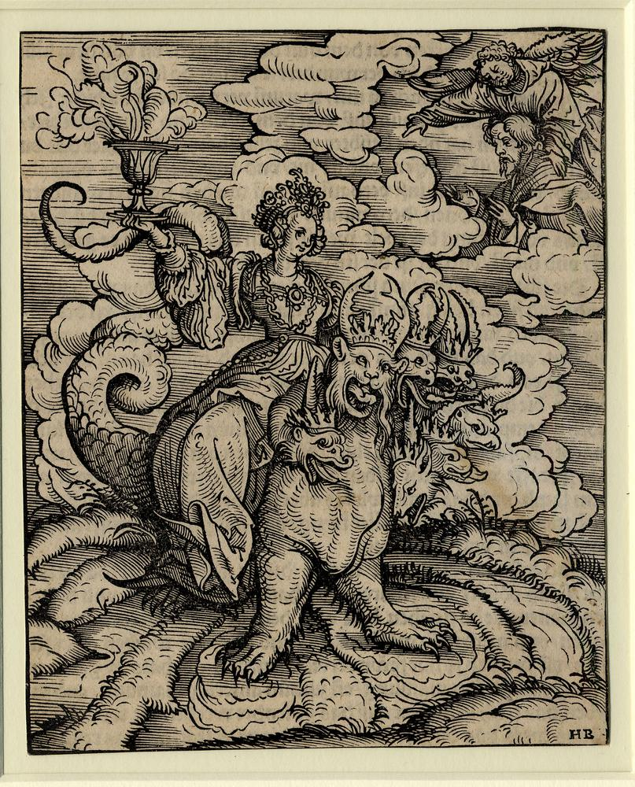
The Beast & 7 Kings (17:7-11)
Revelation’s stated intent is to convey truths via symbols. So, we should view 7 & 10 as symbolic. Yet, many try to force an exact listing of kings. All such attempts end up in contradictions and inconsistencies. 7 & 10 both consistently have symbolic value, namely totality & strength, in Revelation. The challenge comes in that a symbol can also be literally true (e.g., the “7 hills” of Rome).
Mountains are a symbol of strength, reign (cf. 8:8; 14:1; Isa. 2:2; Jer. 51:25; Ezek. 35:3; Dan. 2:35, 45; Zech. 4:7). Kings and mountains are connected.
The seven kings (v. 10) are distinguished from the ten horns/kings (v. 12)

Slide 9
The Beast & 7 Kings (17:7-11)
We do not NEED to establish an exact correspondence between heads & emperors
e.g., Julius Caesar -> Otho
e.g., Augustus -> Domitian
”five have fallen, one is, the other has not yet come” - This is a symbolic note of promise that awful things have happened, are happening, and will happen, yet God will bring it to pass quickly and the kingdom will press forward, despite all odds. Specifically, John is leaning on the apocalyptic method of saying, “The worst has passed us and we are almost there brethren!”
The beast is an 8th king to be counted as one of the seven? Simply put, the imagery overlaps. At the time of writing, the current crown of the harlot was Domitian & he embodied the empire and its wickedness. He was the “Second Nero” (cf. 13:3).
The beast & kings have seen better days – their end is approaching quickly. Remember that the judgment of an enemy speedily was characteristic of apocalyptic lit.
Persecution will ebb & flow. All such efforts will lead to ruin & overthrow of ungodliness.

Slide 10
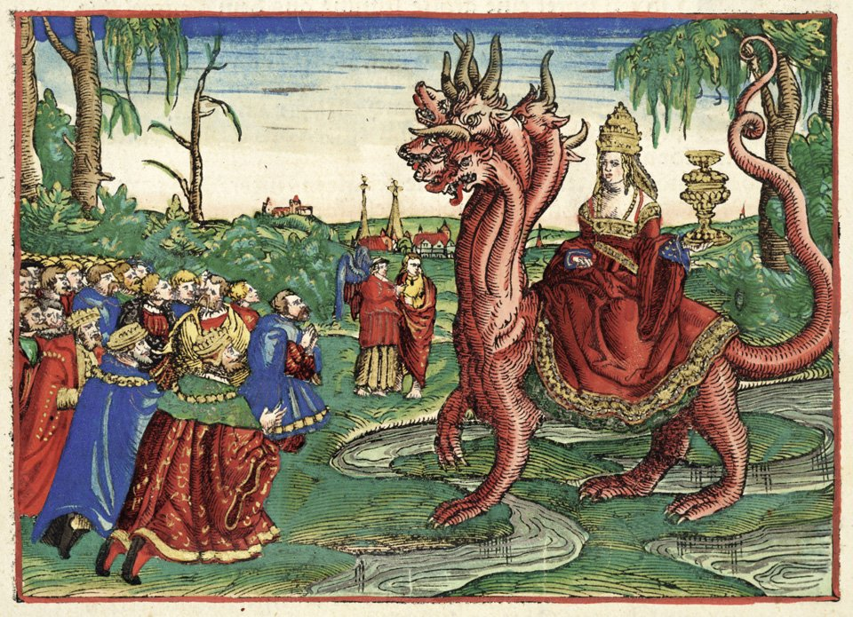
The 10 Horns/Kings (17:12-17)
v. 12 – These ten kings have not received a kingdom. Ambition, greed, & lust for power (“horns”) were contributing to Rome’s downfall.
“One hour” indicates it will be short-lived (cf. 18:10, 17, 19). Still, it was awful. Cornelius Tacitus, a Roman non-Christian described what sorts of persecutions were introduced earlier by Nero: “a vast multitude of Christians were not only put to death, but put to death with insult. They were either clothed in the skins of wild beasts and then exposed in the arena to the attacks of half-famished dogs, or else dipped in tar and put on crosses to be set on fire, and, when the daylight failed, to be burned as lights by night” (Cornelius Tacitus, Annals XV, 44)

Slide 11
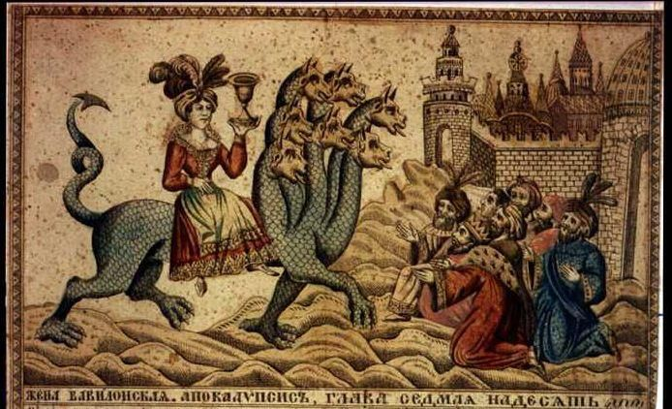
The 10 Horns/Kings (17:12-17)
v. 13 – “One purpose” – unity is not necessarily a good thing, especially when it is evil in intent (contrast 1Cor. 1:10; Phil. 1:27); the Axis Powers were united.
Rome had no power outside of the role of client kings like the Herod family – the power they wield is at the beast’s disposal; emperor worship was most popular in the provinces
The integrity of this unity is compromised. Compare the fourth kingdom of Daniel 2 in which there is no adhesion, true unity, or integral strength.

Slide 12
The 10 Horns/Kings (17:12-17)
v. 14 – This collaboration will be definitively overcome by the Lamb, no matter how united they can become (cf. 12:7-10; 16:14; cf. Ps. 2). The King of kings has control, despite the bloodshed of the saints and the gloating of the civil powers
v. 16 – Allied with the harlot, yet cannibalize the harlot (cf. 19:18; Ezek. 39:17ff; Mic. 3:2f); desolate and naked are OT punishments for idolatry (e.g., Nah. 3:5). Rebels seem to always self-destruct (Judges 7:22; 1 Samuel 14:20; 2 Chronicles 20:23)
v. 17 – God has real power, despite earthly appearances and deceptions, and His unity is true. His unity and His purpose will rule the day! Compare the ”words of God” which will be fulfilled versus the “blasphemies” of the enemy.

Slide 13
An Application of Chapter 17
“Satan has three approaches by which he seeks to destroy the work and people of God: (1) Political or brute force, symbolized by the beast out of the sea; (2) false religion, whether paganism or perverted revealed religion – apostates who hold and teach false doctrines – symbolized by the beast out of the earth; and (3) the world of lust, all that appeals to the flesh or mind (Eph. 2:3; 1 John 2:15-17), represented by the harlot. Against these three the early church waged relentless war; and against these the saint of today must stand immovable and uncompromising” (Hailey 342).

Slide 14
The Overall Message
“These will wage war against the Lamb, and the Lamb will overcome them, because He is Lord of lords and King of kings, and those who are with Him are the called and chosen and faithful.” (17:14; cf. Dan. 4:17, 25, 32)

