Slide 1
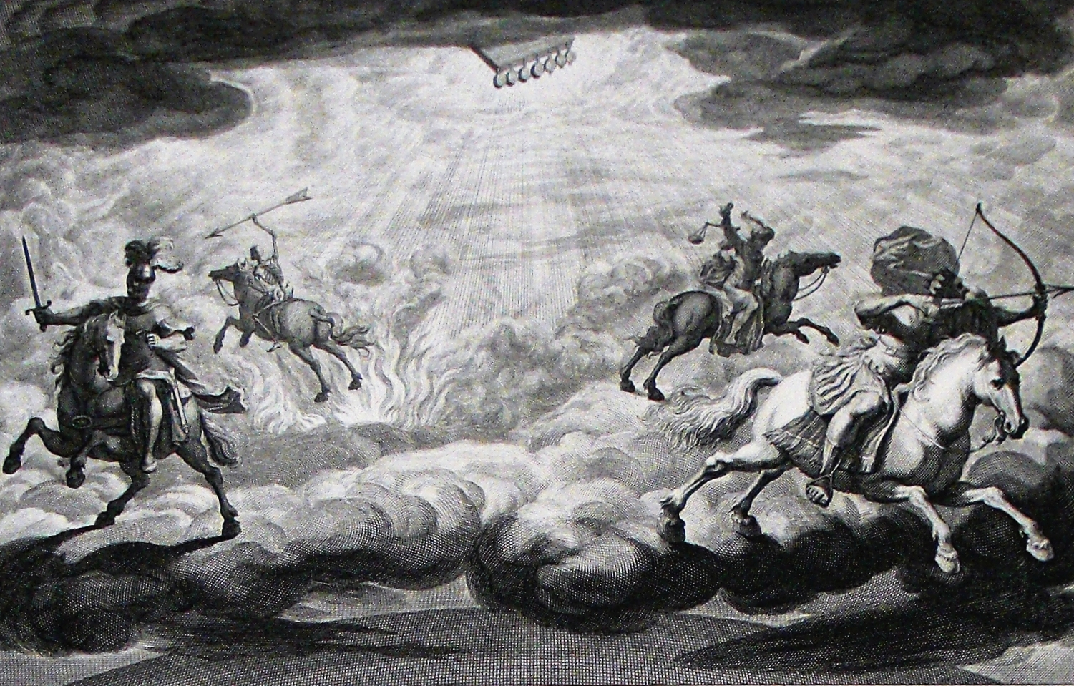
The Book of Revelation

Slide 2
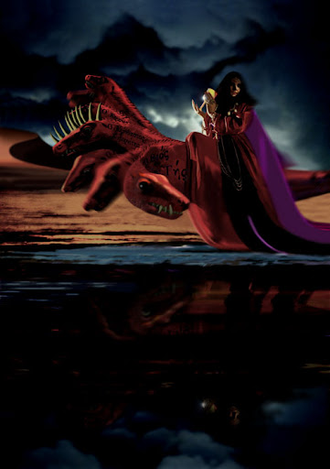
The Big Question: Is This About Rome or Jerusalem?
vv. 11-19 – A great commercial power
vv. 11-19 – A sea-trading power
vv. 11-13 – These goods are more appropriate to the opulence of Rome, not Jerusalem
v. 18 – Most naturally refers to Rome when spoken by the merchants of the world
v. 20 - Saints rejoice over its fall, just like Babylon in Jer. 51:48
Also, no indictment of priests, prophets, etc. characteristic of judgments on Jerusalem

Slide 3
The Old Testament As A Source for Revelation 18
Jeremiah 51:8 | Babylon is fallen & broken | Revelation 18:2a
Jeremiah 51:37 | An unclean heap of ruins | Revelation 18:2b
Jeremiah 51:7 | Nations drunk of her wine | Revelation 18:3
Jeremiah 51:6 | Come out from her! | Revelation 18:4
Jeremiah 51:9 | Her sins reached to heaven | Revelation 18:5
Jeremiah 50:29 | Pay her back for her deeds | Revelation 18:6
Jeremiah 50:32, 34; 51:30, 32, 58 | The Judge is strong, judgment by fire | Revelation 18:8
Jeremiah 51:48 | Heaven rejoices at her fall | Revelation 18:20
Jeremiah 51:64 | She will sink down & not rise | Revelation 18:21
Jeremiah 25:10 | Joy will be stripped from her | Revelation 18:22c-23b
Jeremiah 7:34; 16:9; 25:10; 33:11 | No marriage at this time because of the distress | Revelation 18:23b
Jeremiah 51:49 | She falls because she has slain the righteous | Revelation 18:24

Slide 4
God Has Remembered Babylon’s Iniquities (18:1-8)
A prophetic taunt & summons to fight (cf. Isa. 23-24; Jer. 50-51; Ezek. 26-27; Judg. 5). “Principles don’t change much, so the same language will suit numerous different occasions.” (McGuiggan, 253)
v. 1 – A glorious angel with great authority (cf. 14:8; Ezek. 43:1-3) – in the OT, angels are agents of God’s rule over the nations; in the NT, they are subordinated to the reign of the Son
“Here again we are being told that the work about to be done is begun in heaven! The Lord never tires to tell his people in this book that heaven is completely in control of things. It’s a lesson never too soon learned. How much more at peace we’d be if only we had this as our deep and abiding conviction. Peace would then really guard our hearts and lives.” (McGuiggan, 252)
“By this time, we wonder if the city is going to fall at all…How long shall it be to the end of these wonders? But the lead-up is long-drawn-out, because the issue must be indelibly marked in the mind. The fall must be remembered. It must be wanted, longed for. They must (almost) be impatient for it, so that when it finally comes, it will be relished and absorbed.” (McGuiggan, 252)

Slide 5
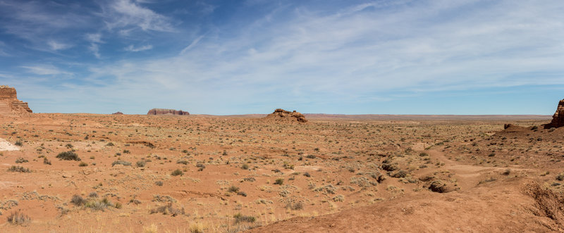
God Has Remembered Babylon’s Iniquities (18:1-8)
v. 2a – She has fallen – cf. Isa. 21:9 (150 years before Babylon fell); Amos 5:1f; “Notice that God has the angel to announce that “Babylon is fallen,” as though it has already happened. When God decides that something is going to happen, it is certain enough for the announcement to be made in the present tense, not merely in the future tense.” (Roger Hillis) John had faith in the sovereignty of God; do we?
v. 2b – A desolate, unclean place – typical language for the judgment of a wicked nation (cf. Isa. 13:9ff; 24:22f; 34:8ff; Zeph. 2:9ff); this would be like NYC, Chicago, or San Francisco turning into a ghost town with tumbleweeds

Slide 6
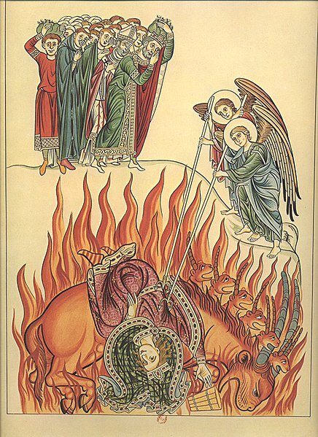
God Has Remembered Babylon’s Iniquities (18:1-8)
vv. 3, 5 – Judgment has come because of her perverse union of politics, immorality, and materialism (cf. 2Chron. 28:9; Jer. 51:7, 9; Isa. 47:15; Nah. 3:4; Ezra 9:6).
“Such connections and associations are seen all over the world today as men seek to gain wealth by immoral, avaricious, and unscrupulous means. Great businesses built on such principles are involved in armaments and munitions deals, including unethical pacts among nations. Internal corruption of a nation is expressed in pornographic moves, magazines, and lewd entertainment, which prey on the depravity of human beings. Underworld establishments of prostitution, gambling, and narcotics make up only a portion of the world of corrupt, anti-God, destructive forces, which thrive on lust.” (Hailey, 359)

Slide 7
God Has Remembered Babylon’s Iniquities (18:1-8)
v. 4 – Another voice exhorts God’s people to “come out from her and be separate” (cf. Isa. 52:11//2Cor. 6:17; Isa. 48:20; Jer. 50:8; 51:6, 9, 45; also, Jer. 4:4f; 6:1; 48:6-8; Mk. 13:14-20). It would have been tempting for the early Christians to compromise. Some at Pergamum and Thyatira were already doing this (2:14, 20-22). It’s easy for us too…but like Abraham, Lot, and Israel we must come out (Eph. 5:11).
v. 6 – Evil doubly paid back (cf. Ps. 137:8; Ezek. 22:4, 7, 9; Isa. 40:2) – she is “more than deserving” of this judgment. We reap what we sow in quality, but we often reap more than we sow in quantity (cf. Hos. 8:7). Double judgment on the wicked brings double joy for the righteous (Isa. 61:7; Jer. 16:18; 17:18; Zech. 9:12).
v. 7 – Shares similarities from Ezek. 27:3; 28:2; Isa. 47:7-11; Zeph. 2:15. Her pride also contributes to her downfall (cf. Isa. 10:12-14; 36:4-20).
v. 8 – Fall in one catastrophic day (cf. Isa. 9:14; 10:17; 47:9); intensifies in 18:10, 17, 19 to “one hour” (cf. 17:12-14); burning is a figure of judgment. Rome was invaded but not burned down.

Slide 8
A Series of Lamentations (18:9-20)
Three ritual laments of the nations with shared elements (i.e., standing far off, weeping/wailing, Alas!, in one hour). These types of laments were common OT descriptions of the destruction of a large empire or city. It was also common in extrabiblical writings (cf. Aeschylus, Persians 249-252)
vv. 9f – Kings of the earth – compare 17:16; how can both be true?
vv. 11-17a – Merchants
vv. 17b-19 – Maritime Workers (Shipmasters, Mariners, Workers of the Sea)
Usually, when Jerusalem falls, pagans rejoice and saints weep. When a pagan city falls, pagans weep and saints rejoice. Compare the laments of Ezek. 27:32; 32:16. They don’t weep out of sympathy; they weep because they have lost their meal ticket!
Calling an influential city a world market was typical in ancient writings (e.g., Isocrates, Panegyricus 42; Strabo 17.1.13; Dio Chrysostum, Or. 13:34-36; Aelius Arist. Or. 17.11-13)

Slide 9
Rome’s World-Famous Ostia Seaport

Slide 10
Rome’s World-Famous Puteoli Seaport

Slide 11
A Series of Lamentations (18:9-20)
The lament of the kings (vv. 9f) – Rome was a protector of the vassal kings of the empire (cf. Ezek. 26:15-18)
The lament of the merchants (vv. 11-17a) – Rome was their main market and source of wealth (cf. Ezek. 27:12-24); the lengthy list of goods is a rhetorical device called polysyndeton (cf. Pliny, Hist. nat. 37.204 which includes 13 of the items listed in Revelation 18); the items came in from all over the world: China, India, Egypt, etc.
The lament of the maritime workers (vv. 17b-19) – Rome was what kept their ships busy and making money (cf. Ezek. 27:28-36; Isa. 47:10)
v. 20 – call for God’s people (saints, apostles, prophets in contrast to the three groups lamenting Rome) to rejoice (cf. 6:10f; Isa. 44:23; Ezek. 35:15; Jer. 51:48)
How do we reconcile this with passages like Prov. 24:17f?
This was not spite; this was longed for and righteous justice
Christians who maintain their faith in and loyalty to God have nothing to fear when judgment falls on the heathen.

Slide 12
Babylon Shall Not Be Found Anymore (18:21-24)
Symbolic action announcing judgment
Third reference to a strong angel in Revelation (cf. 5:2; 10:1)
The millstone was often connected to judgment (cf. Judg. 9:53; Matt. 18:6; Jer. 51:63f)
vv. 22f – typical signs of wealth, luxury, leisure (cf. Isa. 14:11; 24:7-13; Jer. 7:34; 16:9; 25:10; Ezek. 26:13) – all the daily activities of life grind to a halt
v. 24 – cf. 17:6; 19:20; Matt. 23:34f

Slide 13
Application
“What do we learn from this part of the book of Revelation? Certainly John wrote in order to stimulate faithfulness on the part of persecuted Christians living in the first century. He assures them of the ultimate victory of Christ. But Revelation also has a warning for believers down through the years. Babylon is allegorical of the idolatry that any nation commits when it elevates material abundance, military prowess, technological sophistication, imperial grandeur, racial pride, and any other glorification of the creature over the Creator. In these chapters we have an up-to-date portrait of what may occur when we idolize the gross national product, worship growth, and become so preoccupied with quantity that we ignore quality. The message of the book of Revelation concerns the character and timeliness of God’s judgment not only of persons, but also of nations, and in fact, of all principalities and powers—which is to say, all authorities, corporations, institutions, structures, bureaucracies, and the like. And, to the extent that ecclesiastical denominations and sects have succumbed to the lure of power and prestige, the words of John are applicable also to present-day church structures.” (Bruce Metzger, Unlocking the Code, 88)

Slide 14
The Overall Message
“Ultimately, Rome fell because God said it would. He may have used multiple ways of bringing that downfall into reality, but they were doomed because of how they were treating the people of God. It was a matter of God bringing about justice for those persecuted disciples of the first century.” (Roger Hillis)
“We’ve seen a bloody Whore described in her death throes. We’ve been told that heaven is responsible for it. The reasons have been given and the extent and nature of the punishment have been made clear. She stands as a burning warning to all nations and at all times! LEAVE MY PEOPLE ALONE OR SUFFER THE CONSEQUENCES!” (McGuiggan, 2560

