Slide 1
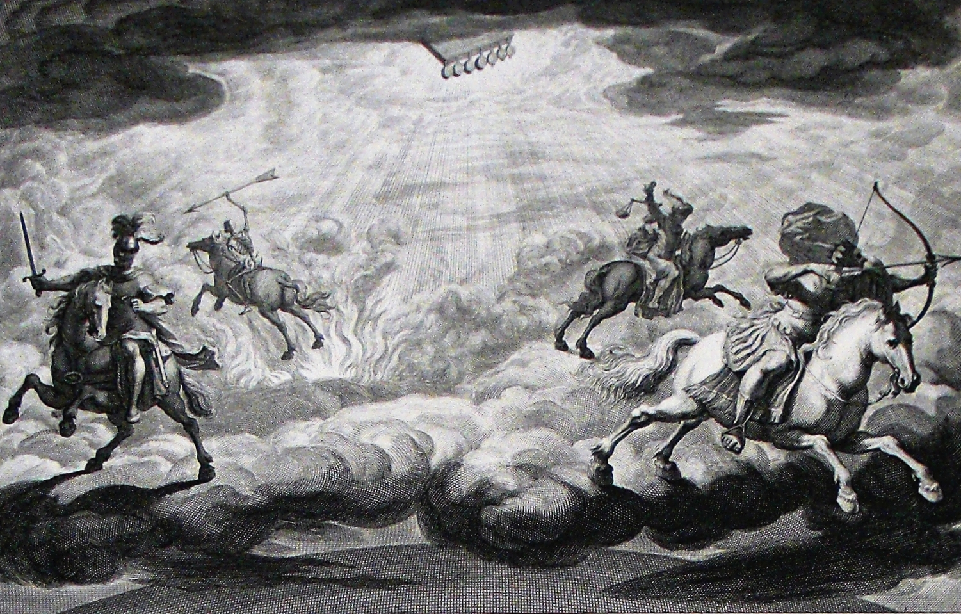
The Book of Revelation

Slide 2
Roman Historian Suetonius (361) on the Death of Emperor Domitian (cf. Rev. 17:15f, et al)
“The Senators on the contrary were so overjoyed, that they raced to fill the House, where they did not refrain from assailing the dead Emperor with the most insulting and stinging kind of outcries. They even had ladders brought and his shields and images torn down before their eyes and dashed upon the ground. Finally they passed a decree that his inscriptions should everywhere be erased, and all record of him obliterated.”

Slide 3
Intro to Chapter 19
In some ways, a summary of the entire book of Revelation
Chapters 1-11 describe the battle between Christians and the Roman Empire
Chapters 12-22 describe the greater battle between Satan and God
Chapters 19-20 show that Jesus will easily win this battle
Chapters 21-22 promises victory to the faithful
Chapter 18 contains psalms of lament; Chapter 19 contains psalms of praise
In chapter 19, we have two VERY different feasts:
vv. 1-10 – A marriage/coronation feast (cf. Feast of Tabernacles in chapter 7)
vv. 11-21 – A grisly carrion feast upon the enemies of God for the birds
Clear OT background from Ps. 2; 110; Ezek. 38-39; Jer. 7:33; 16:3-9; etc.
“This carrion meal is obviously a solemn travesty on the marriage supper of the Lamb, an announcement of which has introduced this scene of punishment (19:9).” (Metzger, 91)

Slide 4
A Fourfold Hallelujah (19:1-6)
vv. 1-6 – Everyone sings hallelujah! This is the only place in the entire NT that uses the term, though it is common in the Psalms as an intro and conclusion, especially in Psalm 104ff.
v. 1 – A great multitude in heaven (cf. Rev. 7 – the saints)
v. 4 – 24 elders and 4 living creatures (cf. 4:4-11)
v. 5 – An unnamed voice from the throne calls for Hallelujah (cf. 11:15)
v. 6 – A great multitude (on earth? (1:1; 2:20; 7:3; 22:6) Or, same as in v. 1?)
OT parallels for such victory songs include Deut. 32:43; Isa. 61:10; “In this grand oratorio all the choirs of heaven unite.” (Metzger, 89)
“The rejoicing stands in bold contrast to the helpless weeping and wailing of the kings, merchants, and mariners who mourned the fall and destruction of the great harlot city.” (Hailey, 373) This is a direct response to the charge of 18:20.
v. 2 – Two reasons for praising God: His judgments are true and righteous (cf. 15:3; 16:7; Deut. 32:4); and, He judged the harlot, avenging His servants (cf. 2Kgs. 9:7)
v. 3 – Smoke ascends forever (cf. 14:10f; Sodom in Jude 7; Edom in Isa. 34:8ff)
v. 6 – NT uses pantokrater 10x; 9/10 of those are in Revelation; He ALWAYS reigns

Slide 5
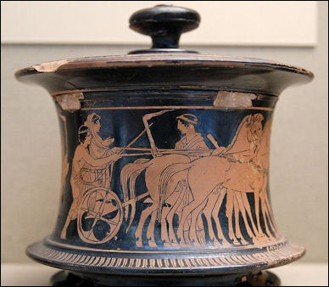
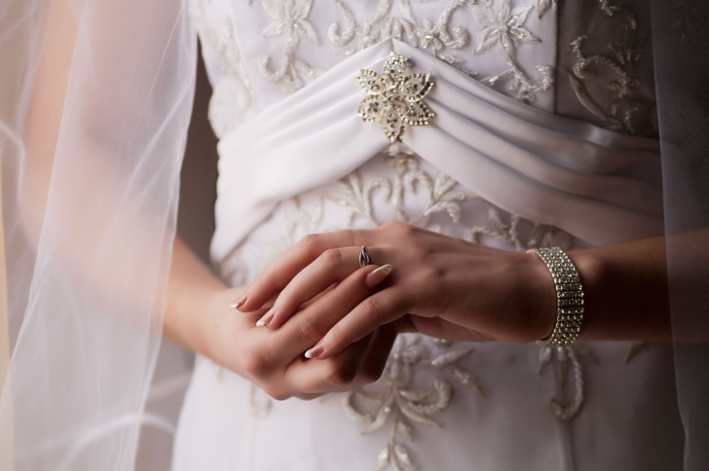
The Marriage Supper (19:7-10)
The beauty and joy of the wedding feast is an intentional contrast with 18:23 where no marriages take place and there is only mourning and sorrow
Ancient weddings – the groom dressed in king-like garb, the bride was adorned with the best the family had, the groom went to get the bride personally to escort her to his home, a joyous processional to the groom’s home, arrival and marriage, a week-long wedding feast where guests were required to wear wedding garments
Christ and His church (e.g., 2Cor. 11:2; Eph. 5:25-32; Mk. 2:20; Matt. 25:1-13) are modeled after the marriage of YHWH and Israel (Hos. 2:19ff; Ezek. 16:7ff; Isa. 49:18; 50:1; 54:1-8; 55:1ff; 62:5; Ps. 45)
Debates about what stage the church is in (betrothal vs. married) miss the point

Slide 6
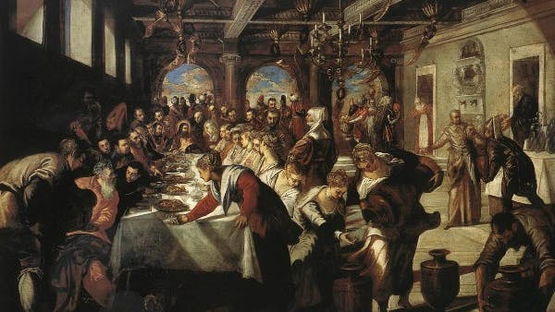
The Marriage Supper (19:7-10)
v. 8 – The purity of the saints (cf. Eph. 5:27) indicates faithfulness throughout the war against Satan and is also a part of the victory of God over the enemy. Note the clothes are “the righteous acts of the saints,” NOT Christ’s imputed righteousness!
v. 9 – The 4th beatitude of the book (cf. Lk. 14:15). Eating is a symbol for fellowship (cf. Isa. 25:6-8; Lk. 22:28-30). Here is combined both coronation banquet and wedding banquet imagery; Jesus reigns AND He is bridegroom.
v. 10 – John’s response (cf. 22:8f; Col. 2:18). Is he overcome by joy? Confused? Mistaken? Whatever it was, it becomes a learning opportunity for us! NOBODY but God is worthy of worship (cf. Matt. 4:10//Deut. 6:13; John 9:35-38). Even an angel is a servant. Whether OT, NT, or Revelation specifically, all true prophecy points to Jesus.

Slide 7
Seven Visions in Rapid Succession
19:11 – “I saw…” (Jesus as a victorious warrior)
19:17 – “I saw…” (Angel calling for feast on God’s enemies)
19:19 – “I saw…” (Armies of earth in battle formation against Christ and His army)
20:1 – “I saw…” (Angel who binds Satan in the abyss)
20:4 – “I saw…” (Saints reign with Christ)
20:11 – “I saw…” (Great white throne judgment)
21:1 – “I saw…” (New heavens and new earth)

Slide 8
Jesus As A Victorious Warrior (19:11-16)
vv. 11-16 – A figurative description of our Lord
Rides on a white horse (purity, holiness, victory, heavenly approval; cf. 6:2)
Names: Faithful and True (1:5; 3:14), Word of God, King of kings and Lord of lords.
He is Judge with eyes of fire (cf. 1:14; Heb. 4:13) – not bothered by emotional irrationalism
Here he wears MANY diadems (royal crowns); contrast the 7 diadems of Satan and the 10 diadems of the beast; Many monarchs would wear more than one crown to visibly illustrate the extent of their rule
His robe is dipped in blood – His own? (cf. 5:6, 9) Or, the blood of the enemy? (cf. 14:14-20; Isa. 63:1-6; Joel 3:9-13)
v. 11 – “How can God’s people hope to win that battle? If the victory should be determined solely on the basis of numbers, then defeat of God’s people would be certain.” (Harkrider, 218; cf. Matt. 7:13f)
v. 12 – The mysterious name suggests he is divine or angelic (cf. Gen. 32:29; Judg. 13:17f); the Son’s true being is only understood by deity Himself (Matt. 11:27).
“Not withstanding the dogmatic helps which the church offers, the mind fails to grasp the inmost significance of the Person of Christ, which eludes all efforts to bring it within the terms of human knowledge. Only the Son of God can understand the mystery of His own Being.” (Swete, 252) In some way, this will be shared with His people (cf. 2:17).
“The profound greatness of Jesus exceeds our full comprehension.” (Harkrider, 219)

Slide 9
Jesus As A Victorious Warrior (19:11-16)
v. 14 – The armies of heaven are either the angels (Dan. 7:10; Matt. 27:53; 25:31; Mk. 8:38; Lk. 9:26; 2Thess. 1:7), or the victorious saints (3:5; 6:11; 7:9, 14; 19:8; Phil. 3:20; Lk. 10:20); “Here are the holy members of the holy family led by their holy Leader moving against the disgusting manifestation of Satanic power.” (McGuiggan, 267)
v. 15 – Sword out of His mouth (cf. 1:16; 2:12, 16; 12:5; Ps. 2:9; 110; Isa. 11:4; Ezek. 21; Heb. 4:12); “Some only want to think of the mild and sweet Jesus. One should never trivialize his qualities of mercy, grace, compassion, and kindness. To his people he is the gentle, loving savior, but to the wicked he is a strong avenger of evil (Rom. 11:22). Any view of God that eliminates his hatred of sin or emasculates his divine vengeance is a perverted view that contradicts the message of Revelation.” (Harkrider, 220f)
v. 16 – He is King of kings and Lord of lords (cf. 17:14; Deut. 10:17; Ps. 136:3; Dan. 11:36). The humbling of Nebuchadnezzar prefigured Christ’s humbling of another foe associated with Babylon.
“The stage is set. Two great powers have been described. In fact, one would think at this point there would be a long, extended battle, but quite the opposite is revealed. Instead of a great struggle, when the battle actually occurs it is described in one brief statement. When the King of kings, and Lord of lords actually enters the fight, the war will soon end. There is none greater, higher, or mightier…Though all the mighty forces of evil come to battle against Christ and crush his army, they are simply outclassed. Great world wars have required years to fight and many volumes to describe, but interestingly, this conflict has no details of the actual war. There is no prolonged battle. It is no contest. Victory in Christ is certain and swift.” (Harkrider, 221)

Slide 10
Jesus As A Victorious Warrior (19:11-16): A Well-Known Apocalyptic Image for the Messiah
In the Scriptures – Isa. 42:13; 63:1-3; Zeph. 3:17; Ex. 15:3f; etc.
Pal. Targum to Gen. 49:11 – “He [i.e., the King Messiah] girds his loins, [and] goes out to battle against those who hate him; and he kills kings and rulers, and reddens the mountains from the blood of their slain; and he whitens his cloak with the fat of their mighty ones; his garments are rolling in blood.”
Targ. Neof. Gen 49:11 – “How beautiful is the King Messiah who is to arise from among those of the house of Judah. He girds his loins and goes forth to battle against those that hate him; and he kills kings with rulers, and makes the mountains red from the blood of their slain and makes the valleys white from the fat of their warriors. His garments are rolled in blood; he is like a presser of grapes.”

Slide 11
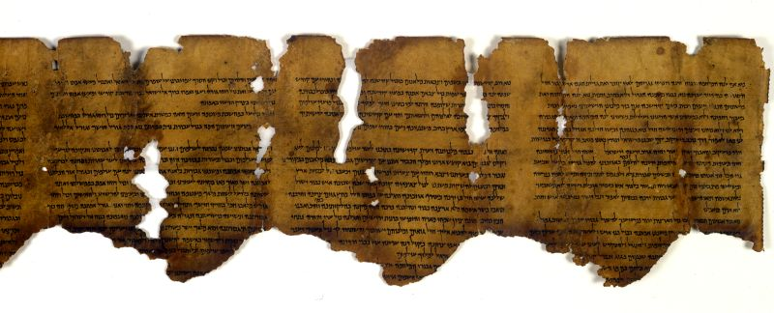
Jesus As A Victorious Warrior (19:11-16): A Well-Known Apocalyptic Image for the Messiah
“It is noteworthy that the victory is won by Christ’s word alone without any military help from the faithful. This picture contrasts sharply with other apocalypses of the period and, in particular, with the War Scroll of the Qumran sect. According to these documents the military help of the faithful is necessary; in fact, the Qumran scroll gives precise directives for the disposition and weapons of the front formations and for the disposition and movements of the cavalry (War Scroll, columns 5-6).” (Metzger, 92)

Slide 12
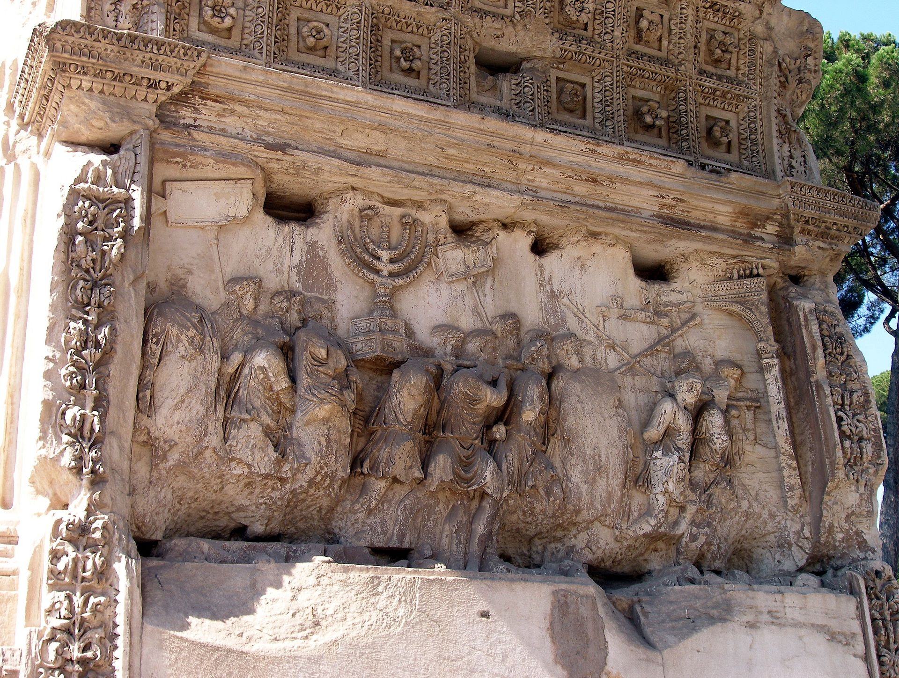
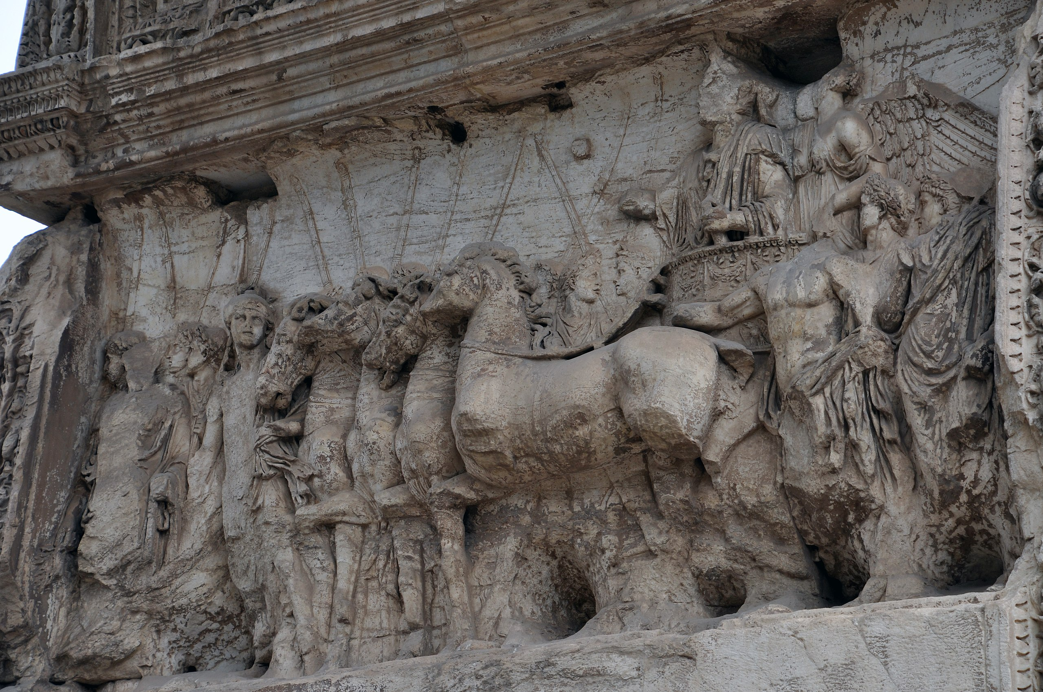
Jesus As A Victorious Warrior (19:11-16): A Direct Mockery of Roman Triumph Parades
In Roman triumph parades, the victor would ride on a white horse, wearing diadems, with their name conspicuously shown. He would be accompanied by armies, spoils would be on display and distributed, and captives would be paraded and then executed.
On the triumphal arch of Titus in the Roman forum, the spoils are displayed, Victory crowns the emperor who rides in a quadriga, the goddess Roma leads the chariot, and the inscription venerates Titus as divine.

Slide 13
The Grisly Feast of the Doomed (19:17-21)
Clear background in the Gog-Magog imagery of Ezek. 38-39; Additional sources include: Ps. 2; Isa. 34:6; 63:1ff; Jer. 46:10; Joel 3:13; Zech. 9:15; 1Sam. 17:46. Also, in the uninspired intertestamental books, Leviathan and Behemoth are served as a dinner for the righteous (2 Apoc. Baruch 29:4; 4 Ezra 6:52)
v. 19 – A climactic battle (cf. Zech. 12:3; 14:2f; Joel 3:2; Ps. 2:1-3; Ezek. 39:1-6; Jer. 17:4; 21:12). Two major enemies from Rev. 13, the (sea) beast (i.e., Rome as a civil persecuting government) and the land beast (aka the false prophet; i.e., a false religious power, namely imperial cult worship), are defeated forever. These enemies are cast into a lake of fire and punishment.
vv. 20f – The harlot had already been utterly burned with fire (17:16; 18:8f, 18); “cast alive” indicates that they fought up until the very moment of punishment; the kings of the earth will join later (20:15). “Lake of fire” does not necessarily indicate Hell (e.g., Matt. 25:46; cf. Isa. 34:8ff with Edom) & can simply mean the ruin of a nation. “the lake of fire stands for the utter defeat of the enemy.” (McGuiggan, 268)
The order of the punishment (harlot, beast & false prophet, Satan) is the opposite of the introduction of these fiends (Satan, beasts, harlot). Dan. 7:11 is fulfilled!

Slide 14
The Overall Message
The subject of final judgment at the end of time is not in view (note the different fates of the enemies: eaten by birds; cast into the lake of fire). It is tempting at the end of Revelation to deviate from the context and imagery of limited judgment and leap through time to the end of all things. While there are no doubt eternal implications to what befalls God’s people and their enemies, Revelation focuses specifically on the earthly situation (remember “shortly come to pass”). Being cast into a lake of fire is a graphic image of total destruction. God’s enemies get God’s wrath; God’s people get God’s blessing.
“This is not a description of Jesus’ ‘second’ or final coming, but of the victorious war against the forces that have been under discussion…In His final appearance Jesus will come to judge and reward, not to wage war with His enemies. Therefore the judgment and battle in this vision are against the enemy forces in time, not at the end of time.” (Hailey, 381f)
“This particular battle of Armageddon was fought centuries ago. The Roman Empire backing the pagan god-Caesar worship was destroyed, thus the persecuting force against the church was brought down. In principle, other ‘Armageddons’ have taken place and perhaps shall yet be in the future because Satan continues to wage battle against the purpose of God. Satan did not cease to exist, and he has employed other methods to fight against the kingdom of God on earth.” (Harkrider, 223)

Slide 15
The Overall Message

