Slide 1
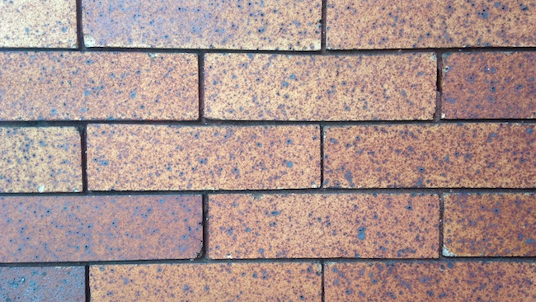
Brick By Brick
A Servant’s Heart

Slide 2
C U L T U R E
O
L
L
E
C
T I V E L Y
P
L I F T I N G
I V E S
H R O U G H
T I L I Z I N G
E S O U R C E S
V E R Y D A Y

Slide 3
1.) Being a servant means giving up my rights for others.
A Servant’s Heart

Slide 4
How do you view yourself?
3 For by the grace given me I say to every one of you: Do not think of yourself more highly than you ought, but rather think of yourself with sober judgment, in accordance with the faith God has distributed to each of you.
(Romans 12:3)

Slide 5
Why do we serve?
Therefore if you have any encouragement from being united with Christ, if any comfort from his love, if any common sharing in the Spirit, if any tenderness and compassion, 2 then make my joy complete by being like-minded, having the same love, being one in spirit and of one mind. 3 Do nothing out of selfish ambition or vain conceit. Rather, in humility value others above yourselves, 4 not looking to your own interests but each of you to the interests of the others.
(Philippians 2:1-4)

Slide 6
Who do we serve like?
5 In your relationships with one another, have the same mindset as Christ Jesus:
(Philippians 2:5)

Slide 7
What Humility looks like…
6 Who, being in very nature God,
did not consider equality with God something to be used to his own advantage;
(Philippians 2:6)
14 The Word became flesh and made his dwelling among us. We have seen his glory, the glory of the one and only Son, who came from the Father, full of grace and truth.
(John 1:14)

Slide 8
Are you too good to serve?
7 if it is serving, then serve
(Romans 12:7a)

Slide 9
We are going to have to give up our rights, give up our privileges, in deference to others.

Slide 10
2.) Becoming a servant means becoming less so others can become more.
A Servant’s Heart

Slide 11
“NOTHING”
7 rather, he made himself nothing
by taking the very nature of a servant,
being made in human likeness.
(Philippians 2:7)
30 He must increase, but I must decrease.
(John 3:30)

Slide 12
Heaven / Cross
Being Served / Serving
Robes / Rags
Songs of Heaven / Cries from an angry mob

Slide 13
If we are going to be like Jesus, we must become servants, allowing others to become more at our expense.
26 Then he released Barabbas to them; and when he had scourged Jesus, he delivered Him to be crucified.
(Matthew 27:26)

Slide 14
3.) Servanthood means being obedient whatever the cost
A Servant’s Heart

Slide 15
The Cost of the Cross
8 And being found in appearance as a man,
he humbled himself
by becoming obedient to death—
even death on a cross!
(Philippians 2:8)
Notes:
The early church did not view the cross the same way we do. They did not wear them around their necks or in their ears as earrings. Can you imagine if someone today had a solid gold electric chair and put diamonds in it? People would think they were nuts. In the world Paul shared with the Philippians, crucifixion was the lowest anyone could stoop, socially. Crucifixion was the cruelest form of official execution in the Roman Empire. Crucifixion was not the conversation of polite company and because of the cruelty of the executioners; the specifics of the process are not frequently described. The victim was first tortured in various ways and then fastened to a cross by impaling, nailing, binding with ropes, or some combination of all three. Death often came slowly over a period of days as the victim experienced increased blood loss, thirst, hunger, the attacks of wild animals and suffocation. It is on the cross that the true nature of God is revealed. God is love. He came to give Himself for us, to die for us, to die at our hands, because that's what it took to redeem us, to buy us back from the condemnation we brought upon ourselves through our sin.
There is nothing He will ever ask of us that will cost us as much as going to the cross cost Him. We can never give up as much as He gave up. We can never humble ourselves as much as He humbled Himself. We must, however, be willing to do whatever He asks, whenever He asks, wherever He asks.

Slide 16
The Cost of the Garden
44 And being in agony, He prayed more earnestly. Then His sweat became like great drops of blood falling down to the ground.
(Luke 22:44)
Notes:
The early church did not view the cross the same way we do. They did not wear them around their necks or in their ears as earrings. Can you imagine if someone today had a solid gold electric chair and put diamonds in it? People would think they were nuts. In the world Paul shared with the Philippians, crucifixion was the lowest anyone could stoop, socially. Crucifixion was the cruelest form of official execution in the Roman Empire. Crucifixion was not the conversation of polite company and because of the cruelty of the executioners; the specifics of the process are not frequently described.

Slide 17
4.) Servanthood will be rewarded
A Servant’s Heart

Slide 18
Jesus’ Reward
9 Therefore God exalted him to the highest place
and gave him the name that is above every name,
10 that at the name of Jesus every knee should bow,
in heaven and on earth and under the earth,
11 and every tongue acknowledge that Jesus Christ is Lord,
to the glory of God the Father.
(Philippians 2:9-11)
Notes:
Because Jesus was obedient, because He humbled Himself, because He was willing to pay the price, He will be exalted. The Father has given Him the name at which every knee will bow and tongue confess that He is Lord. God is Faithful!!!

Slide 19
Do you want to be exalted?
11 But he who is greatest among you shall be your servant. 12 And whoever exalts himself will be humbled, and he who humbles himself will be exalted.
(Matthew 23:11-12)

Slide 20
Will you humble yourself?
11 But he who is greatest among you shall be your servant. 12 And whoever exalts himself will be humbled, and he who humbles himself will be exalted.
(Matthew 23:11-12)

Slide 21
Who do you want to be exalted by?
10 Humble yourselves before the Lord, and He will exalt you.
(James 4:10)

Slide 22
