Slide 1
HOW TO APOLOGIZE

Slide 2
The Duty of Forgiveness
The Divine Example
Forgiveness is in God’s character; it should therefore be in the character of His people
He sent His Son to bring forgiveness
God’s forgiveness is openly proclaimed and all who truly believe in Him are forgiven
God’s Commands
Our forgiveness requires we forgive others and that we seek forgiveness when we are in the wrong
There is no excuse for putting off the resolution of conflict
Christians must seek harmony and forgive in limitless measure

Slide 3
Obstacles to Apologizing
Limited concern for the victim and/or the relationship – “It doesn’t matter” or “It’s not important to me”
Assumption of apology ineffectiveness – “They won’t or they can’t forgive me”
Perception of apology as a threat to one’s self-image – “It will make me look weak, stupid, or unspiritual”

Slide 4
The Power of Apologizing
Power to Properly Value and Appreciate Grace
Power to Heal and Reconcile Broken Relationships
Power to Free Yourself from the Weight of Guilt
Power to Be Mature & Courageous

Slide 5
A “How-To” for Christians
Reflect on Biblical Apologies
Evaluate What Went Wrong and Personally Acknowledge the Damage It Caused
Pray to the Lord
Take Initiative: Go, Verbalize, Acknowledge Without Defensiveness, Express, Pursue
Follow Through: Commit, Contribute, Appreciate, Sacrifice

Slide 6
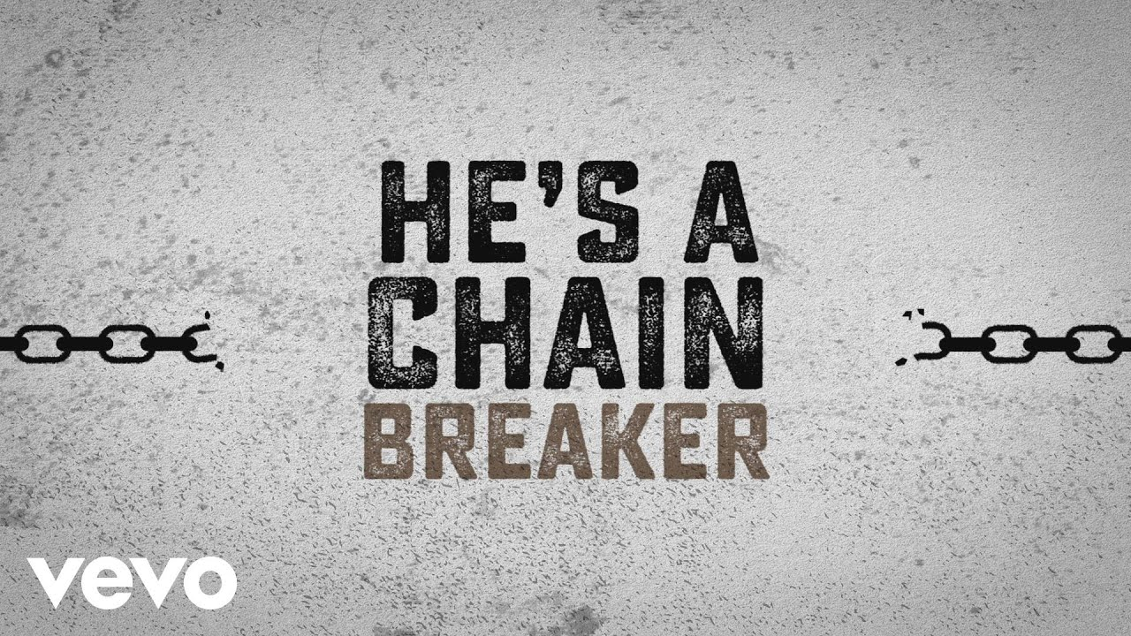
Apologize and You Will Be Forgiven

