Slide 1
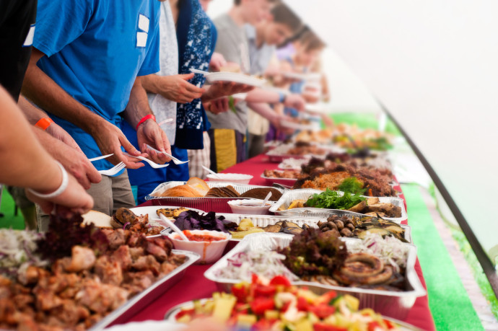
Love Feasts
What Were They?
Are They The Same As What Some Churches Do Today?
What Does Jude 12 Tell Us About Our Own Worship?
Are We Missing Something? Have We “Left The Apostolic Pattern?”

Slide 2
Jude 12-13
“These are the men who are hidden reefs in your love feasts when they feast with you without fear, caring for themselves; clouds without water, carried along by winds; autumn trees without fruit, doubly dead, uprooted; wild waves of the sea, casting up their own shame like foam; wandering stars, for whom the black darkness has been reserved forever.”

Slide 3
This is not a new position/argument
The argument from Jude 12-13 traditionally goes that early church writers interpreted and applied the term “love feast” to a common meal, or a fuller meal in tandem with the Lord’s Supper. Appeals are made to the writings of Ignatius, Clement of Alexandria, Tertullian, and other Ante-Nicene Fathers.
Popular Lexicons Make This Argument:
Thayer’s – “feasts expressing and fostering mutual love which used to be held by Christians before the celebration of the Lord's supper, and at which the poorer Christians mingled with the wealthier and partook in common with the rest of food provided at the expense of the wealthy”
BDAG – “a common meal eaten by early Christians in connection with their worship, for the purpose of fostering and expressing mutual affection and concern, fellowship meal, a love-feast”

Slide 4
Preliminary Issues with this rationale
Lexicography and Commentating are two different areas
The average Christian has little to no knowledge of these extrabiblical sources. Appeals to these writers are often met with audience ignorance.
These arguments rely on phrases like: “the majority of scholars,” “the opinion of many,” “seems to,” “possibly,” & “appears to.”
Ante-Nicene writings often speak of developments that became heretical. This is the case in their record of the trend to separate the Lord’s Supper from “the Eucharist.”
There are Ante-Nicene writers who do not mention “love feasts” at all, or that clearly identify them as equivalent to the Lord’s Supper alone.
In sum, the data, interpretations, and applications in the early church and in modern commentaries of the views of the early church are mixed at best. We do not KNOW the things that advocates often say we know.

Slide 5
We are experiencing Modern takes on age-old arguments
What were the historical catalysts in the 20th-21st centuries?
Note though B.C. Goodpasture’s comments in the Gospel Advocate in 1951: “It is not the mission of the church to furnish amusement for the world or even for its own members. Innocent amusement in proper proportion has its place in the life of all normal persons but it is not the business of the church to furnish it...The church was not established to feature athletics...For the church to turn aside from its divine work to furnish amusement and recreation is to pervert its mission. It is to degrade its mission.... Building recreation rooms, and providing and supervising recreational activities at the expense of the church, is a departure from the simple gospel plan as revealed in the New Testament….The church might as well relieve the parents of feeding and disciplining all of the young people at church expense as to take over the job of entertaining and supervising the recreation at church expense.”

Slide 6
A Peacemaking thought to guide us
“Let me say again, that when differences arise, and it doesn't matter whether it's over these things that we've been talking about, or over divorce and remarriage, or whatever, one of our problems is we don't listen to one another. We either already have our minds made up, or we are thinking about what we are going to say next, or how we're going to answer this person, that we really don't listen. And consequently, a lot of times, we try to answer an argument before we even know the argument. We try to answer an issue before we even know what the issue is. And we make a very sad mistake. I may have been guilty of that. Any of us may have been. But we need to listen to one another.” (“Kitchens and Fellowship Halls: What Was the Issue?” By Bill Hall)

Slide 7
How Do we establish God’s Approval?
CENI (Command, Approved Example, Necessary Inference) otherwise known as TSI (Tell, Show, Imply)
“TSI [aka CENI] is foundational to any form of communication. There is no communication without it. It is inherent in any spoken or written communication (not just in studying the Bible). It is not, in itself, a hermeneutic or method of interpreting, but is rather foundational to any hermeneutic. That is, any hermeneutic will already assume the reality of TSI. Hermeneutics is the science of interpretation. It is what we as the recipients (readers, hearers) bring to the communication process. TSI, on the other hand, is inherent in what the communicator gives. That is, we, the readers or listeners, do not provide the TSI; we take the TSI that is given to us and try to understand what that means. TSI, then, is not a method of interpretation; it is the material that we try to interpret…

Slide 8
How Do we establish God’s Approval?
CENI or TSI
…We might misinterpret it. We might fail to get out of it what is intended. Nevertheless, it is the raw material that we use in order to try to understand what the author or speaker intends. There is no getting around this. No one interprets anything that is not first told, shown, or implied in some way. We are speaking of the bare bones of what we work with when we do interpret. Instead of criticizing the communication process, let’s recognize it for what it is and then deal with how we should properly understand the statements, examples, and implications.” (Moyer, Doy. Mind Your King: Lessons and Essays on Biblical Authority (pp. 180-181). Moyer Press)
Ultimately, there are two types of authority (Matthew 21:23-27). What we are looking for is not human authority, but rather divine authority.

Slide 9
What does Jude 12-13 itself indicate?
This is the ONLY place the term is used in the Bible. By itself, it is also unspecified whether we are to even observe them.
The word itself (AGAPAIS) by itself just means “loves.” There is also a manuscript variant here (APATAIS) which may make the reading “deceptions.”
IF it is AGAPAIS, the use of a definite article (TAIS) and the following verb, SUNEUOCHEOMOI, which does mean “feasting,” may indicate that the typical translation of “love feast” may be accurate.
There is nothing in the text which tells us where or how they observed them. In this absence, is it wise to make assumptions? (Leviticus 10:1-3; 2 Samuel 6:1-11; Hebrews 7:14)
The parallel in 2 Peter 2:13 provides no additional insight.

Slide 10
Are There Other Options?
"All reasoning contains inferences or interpretations by which we draw conclusions and give meaning to data. To what extent do the data support your conclusions? Are your inferences consistent with each other? Are there other reasonable inferences that should be considered?" (Paul, Richard; Elder, Linda. “Miniature Guide to Critical Thinking Concepts and Tools.” Foundation for Critical Thinking)

Slide 11
Are There Other Options?
Potlucks OUTSIDE the Weekly Assembly (Acts 2:46 - ”daily meals”)
Church-Sponsored Benevolence Meals for POOR Members (Acts 2:45; 4:34-35; 11:27-30; Romans 15:26; 1 Corinthians 16:1-3; 2 Corinthians 8-9)
Church-Sponsored Benevolence Meals for WIDOWS INDEED (Acts 6:1-6; 1 Timothy 5:3-16)
The Lord’s Supper BY ITSELF (John 13:34-35; 14:15-31; 15:9-17; 1 Corinthians 5:6-8; Acts 20:7; 1 Corinthians 11:22ff)

Slide 12
Can We confidently identify and show divine authorization for “love feasts” as observed today?
Are we directly told to observe “love feasts” in Jude 12-13. No.
Are “love feasts” set forth as clearly approved examples in Jude 12-13? No.
Do the “love feasts” of Jude 12-13 provide a direct and inescapable inference or forced conclusion that we should be observing either a fuller Passover meal in conjunction with the Lord’s Supper, or a common meal for any & all attendants, provided for by the collective assets of the church? No.

Slide 13
Love Feasts
Due to the lack of information and heavy reliance of proponents of social meals upon unclear extra-biblical sources (who in various and demonstrable ways often show heretical views), it is exceedingly precarious to identify love feasts as social meals in or adjacent to the assembly. Moreover, to use this shabby scaffolding to justify building $50,000 kitchens and million-dollar “fellowship halls” flies in the face of responsible Bible interpretation.

