Slide 1
The Taylorsville Road Church Of Christ
2024 Theme Reveal

Slide 2
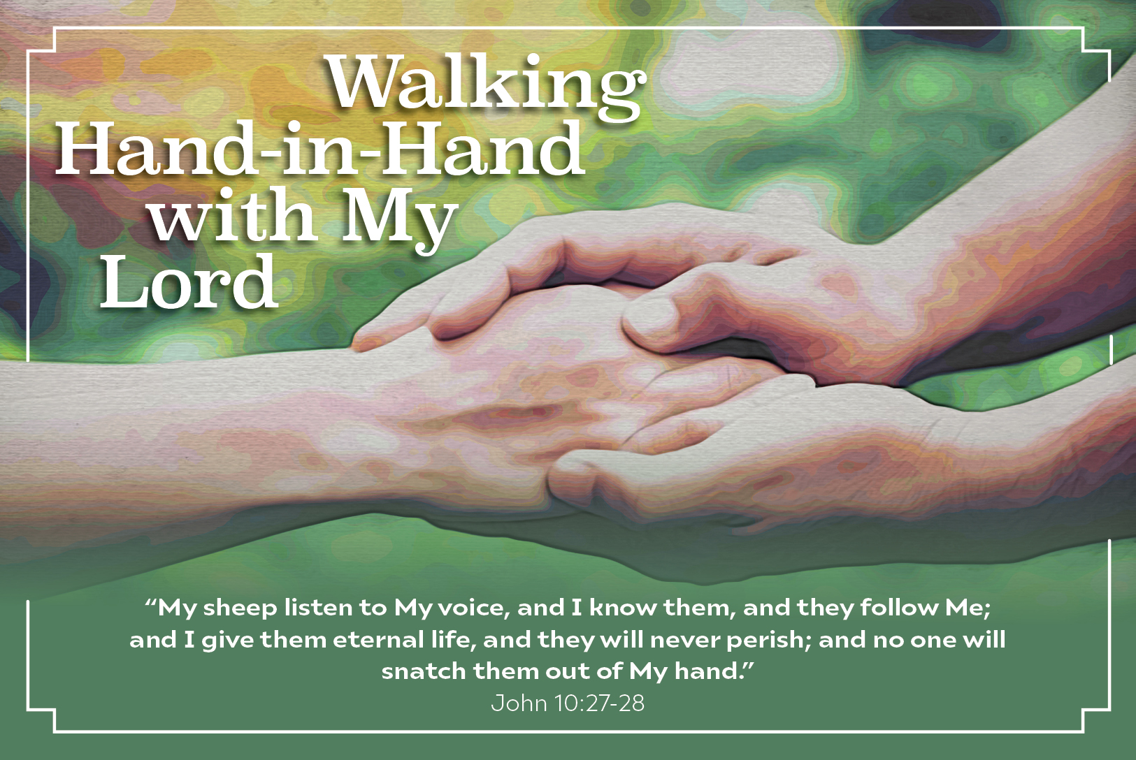
2023 Highlights

Slide 3
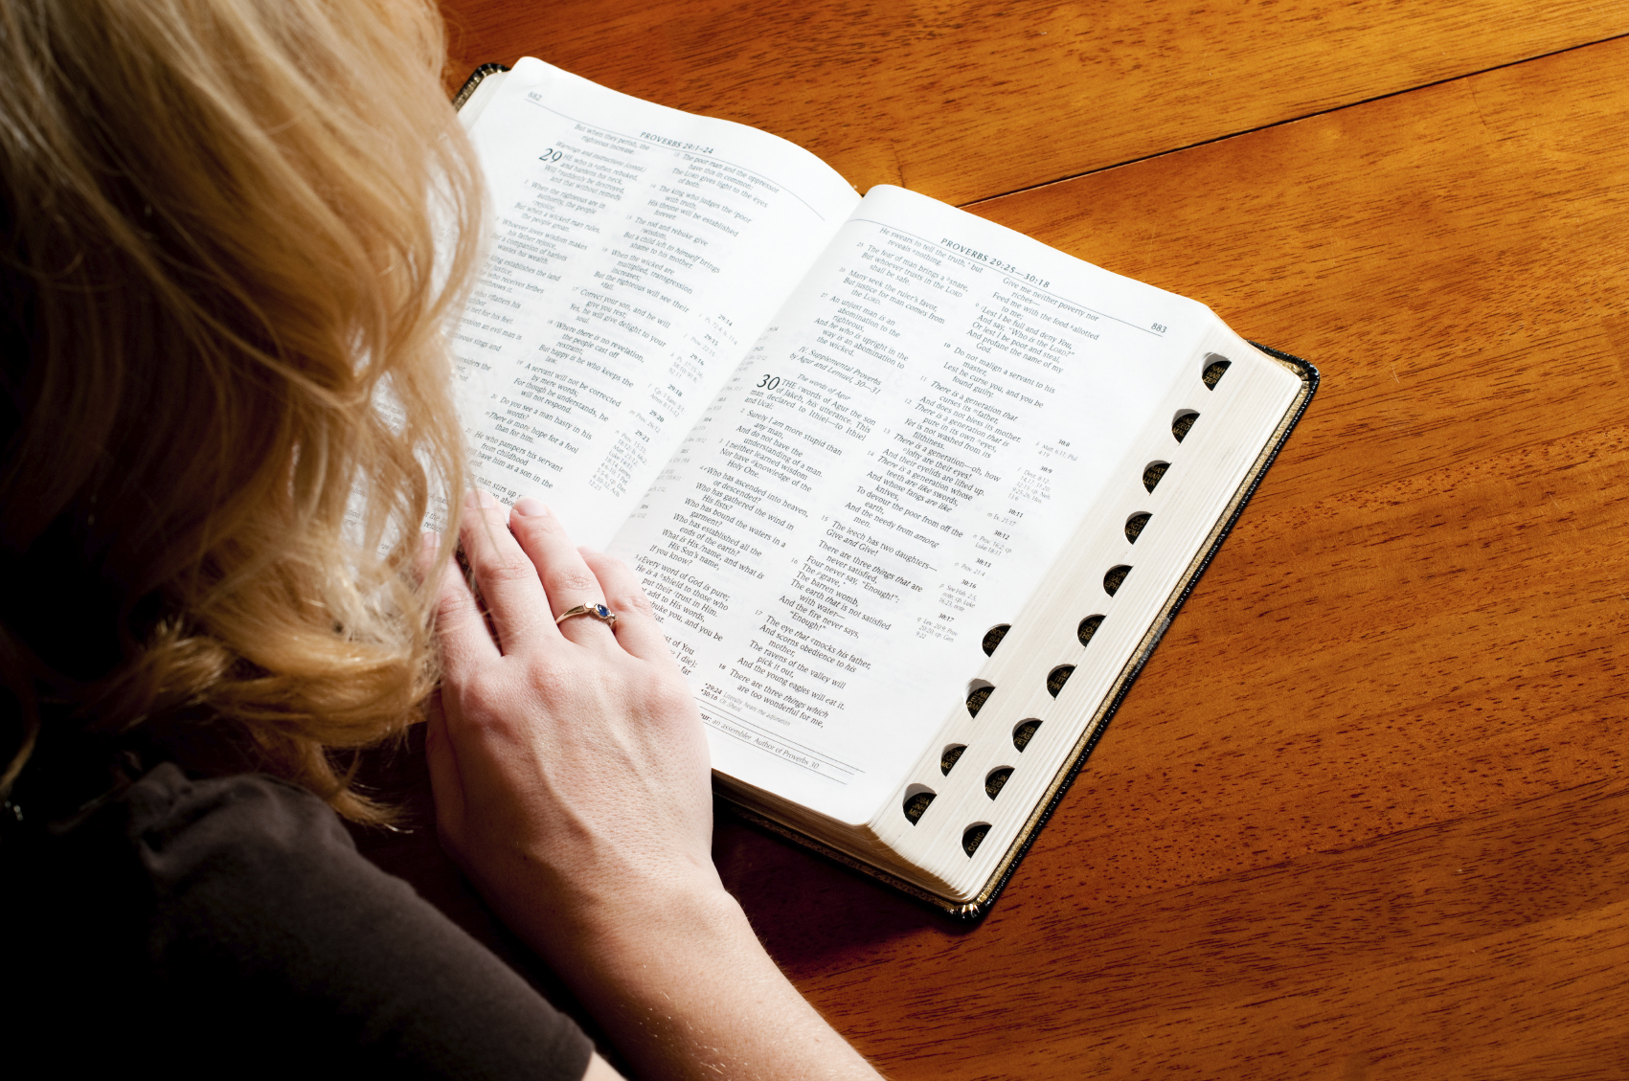
Adult Bible Classes:
Textual Studies: 1st Corinthians; Ecclesiastes; 1st, 2nd, & 3rd John; Hebrews
Topical Studies: I AM: Practical Lessons in Theology; Angels, Demons, and the Spirit World; Biblical Creationism; Our Awesome God; The Sin of Lying; Fruit of the Spirit

Slide 4
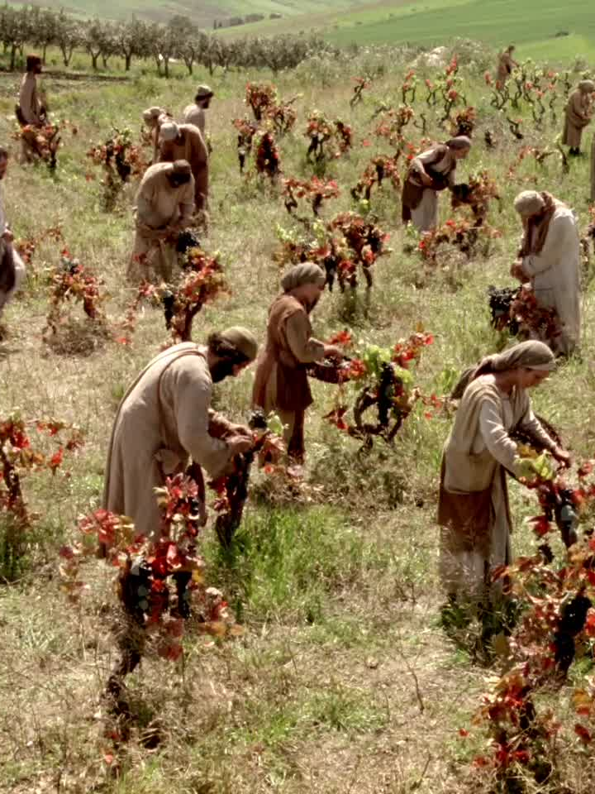
Contributions:
Wednesday night invitations
Women teachers & children’s classes
Men facilitating the Lord’s Supper
Song & prayer leaders
Men’s & ladies’ study groups
Providing transportation
Preparing the Lord’s Supper & cleaning the building
Work groups
Deacons

Slide 5

Online Presence
Website/Facebook/YouTube – We continue to upload videos, audio from sermons & Bible studies.
*Please inquire if you would like a tutorial on how to navigate the website, Facebook, or YouTube pages.*

Slide 6

2023 Topical/Textual Sermons
“Grab My Hand!”
“Making it Through the Valley (Psalm 23)”
“Watch Your Step! The Minefield of the World”
“Walking As My Lord Walks (Ephesians 5)”
“Enoch: A Man Who Walked With God”
“Walking Hand-in-Hand With One Another”
“Secure in My Father’s Hand”

Slide 7

2023 Hymn Lessons
“Trust and Obey” (#505)
“Just A Closer Walk With Thee” (#416)
“Walk Beside Me” (#675)
“O Love That Will Not Let Me Go” (#434)
“O Master Let Me Walk With Thee” (#584)
“Heavenly Sunlight” (#663)

Slide 9
Our 2024 Congregational Theme Will Be…

Slide 10


Slide 11
Key Passages for Our Theme

Slide 12
Psalm 119:125
“I Am Your servant; give me understanding, That I may know Your testimonies.”

Slide 13
Mark:10:44-45
“…and whoever wishes to be first among you shall be slave of all. For even the Son of Man did not come to be served, but to serve, and to give His life a ransom for many.”

Slide 14
Luke 1:48
“For He has had regard for the humble state of His bondslave; For behold, from this time on all generations will count me blessed.”

Slide 15
Colossians 3:23-24
“Whatever you do, do your work heartily, as for the Lord rather than for men, knowing that from the Lord you will receive the reward of the inheritance. It is the Lord Christ whom you serve.”

Slide 16
1 Peter 4:10
“As each one has received a special gift, employ it in serving one another as good stewards of the manifold grace of God.”

Slide 17
Key Learning Opportunities in 2024

Slide 18

2024 Bible Classes
Sunday Morning Adult Bible Class:
Hebrews; Ezekiel
Wednesday Night Adult Bible Class:
Fruit of the Spirit; Judges; Unlikely Servants of God
Children’s Bible Classes:
Foundational Bible Lessons and Apologetics, Taught By Rotating Teachers

Slide 19
2024 Topical/Textual Sermons
“A Servant’s Heart”
“Not Mine, But Your Will Be Done”
“Mary: God’s Chosen Servant (Lk. 1)”
“Pleasing God Rather Than Man”
“A Faithful vs. An Unfaithful Servant”
“I Gave You An Example (John 13)”
”From the Form of God to the Form of a Servant (Phil. 2)”
“We Serve the Same Master (Philemon)”
”He Came to Serve (Matt. 20:28)”

Slide 20
2024 Hymn Lessons
“Servant Song” (#591)
“I Want to Be a Worker for the Lord” (#589)
“Room in God’s Kingdom” (#587)
“A Beautiful Life” (#624)
“Lord Send Me” (#781)
“To the Work” (#588)
”O the Things We May Do” (#629)
“Something for Thee” (#607)

